Slide 1
GetKanban
Day 9 Guide
Slide deck developed by James Carpenter

Slide 2
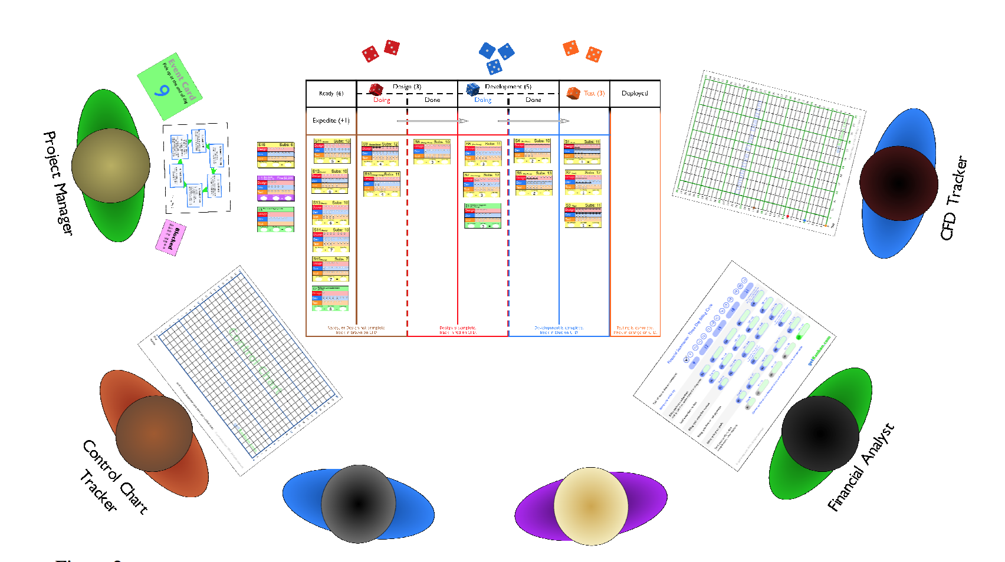
Game Board Setup

Slide 3
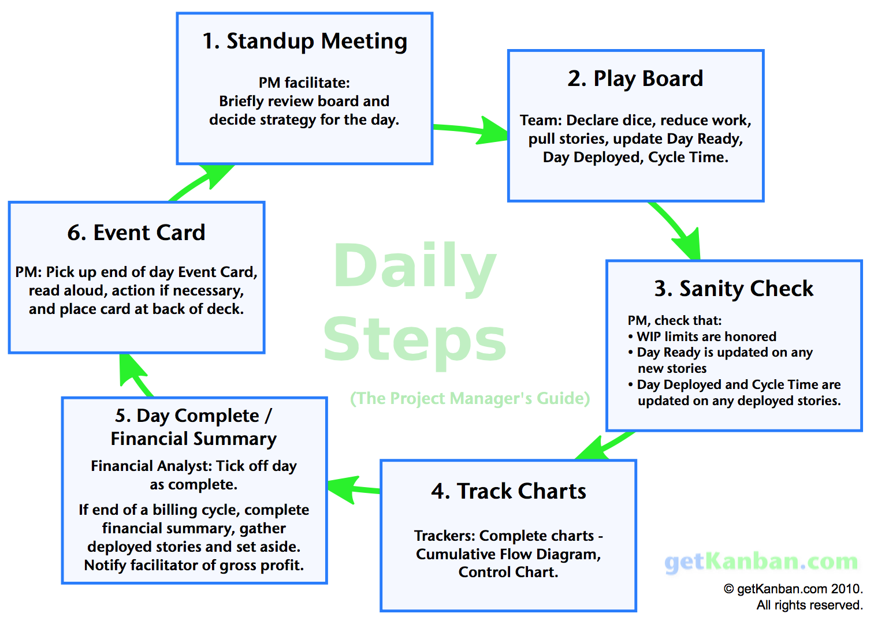

Slide 4
Day 9: Standup Meeting
Team Decisions:
Specialists work in their own specialization
Orange Dice: Test
Blue Dice: Development
Red Dice: Design
Happy with existing story order

Slide 5
Rule Reminders:
The game requires the team decide how to allocate dice (people with specialized skill-sets) at the beginning of each day. Once decided, this can not be changed until the next day. This rule simulates context switching costs.
You can not wait until you know the dice roll results to decide what story to spend the points on. Rolling dice incrementally allows you to re-prioritize stories mid-day.

Slide 7
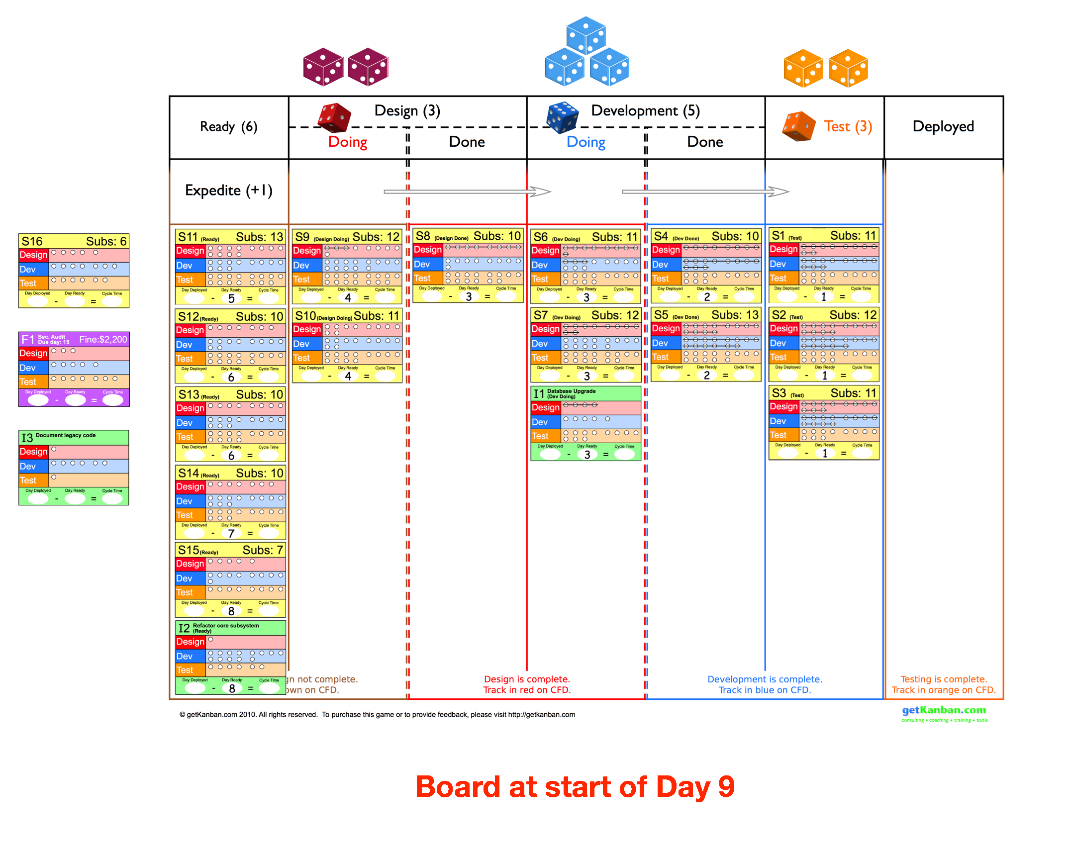

Slide 8
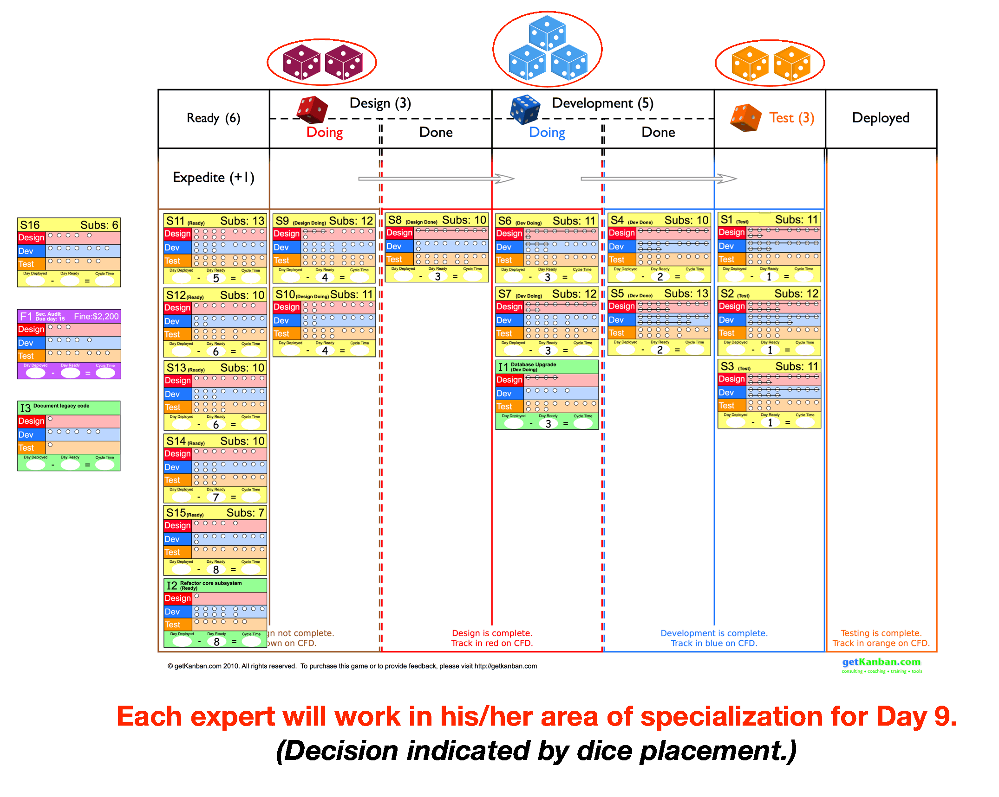

Slide 9
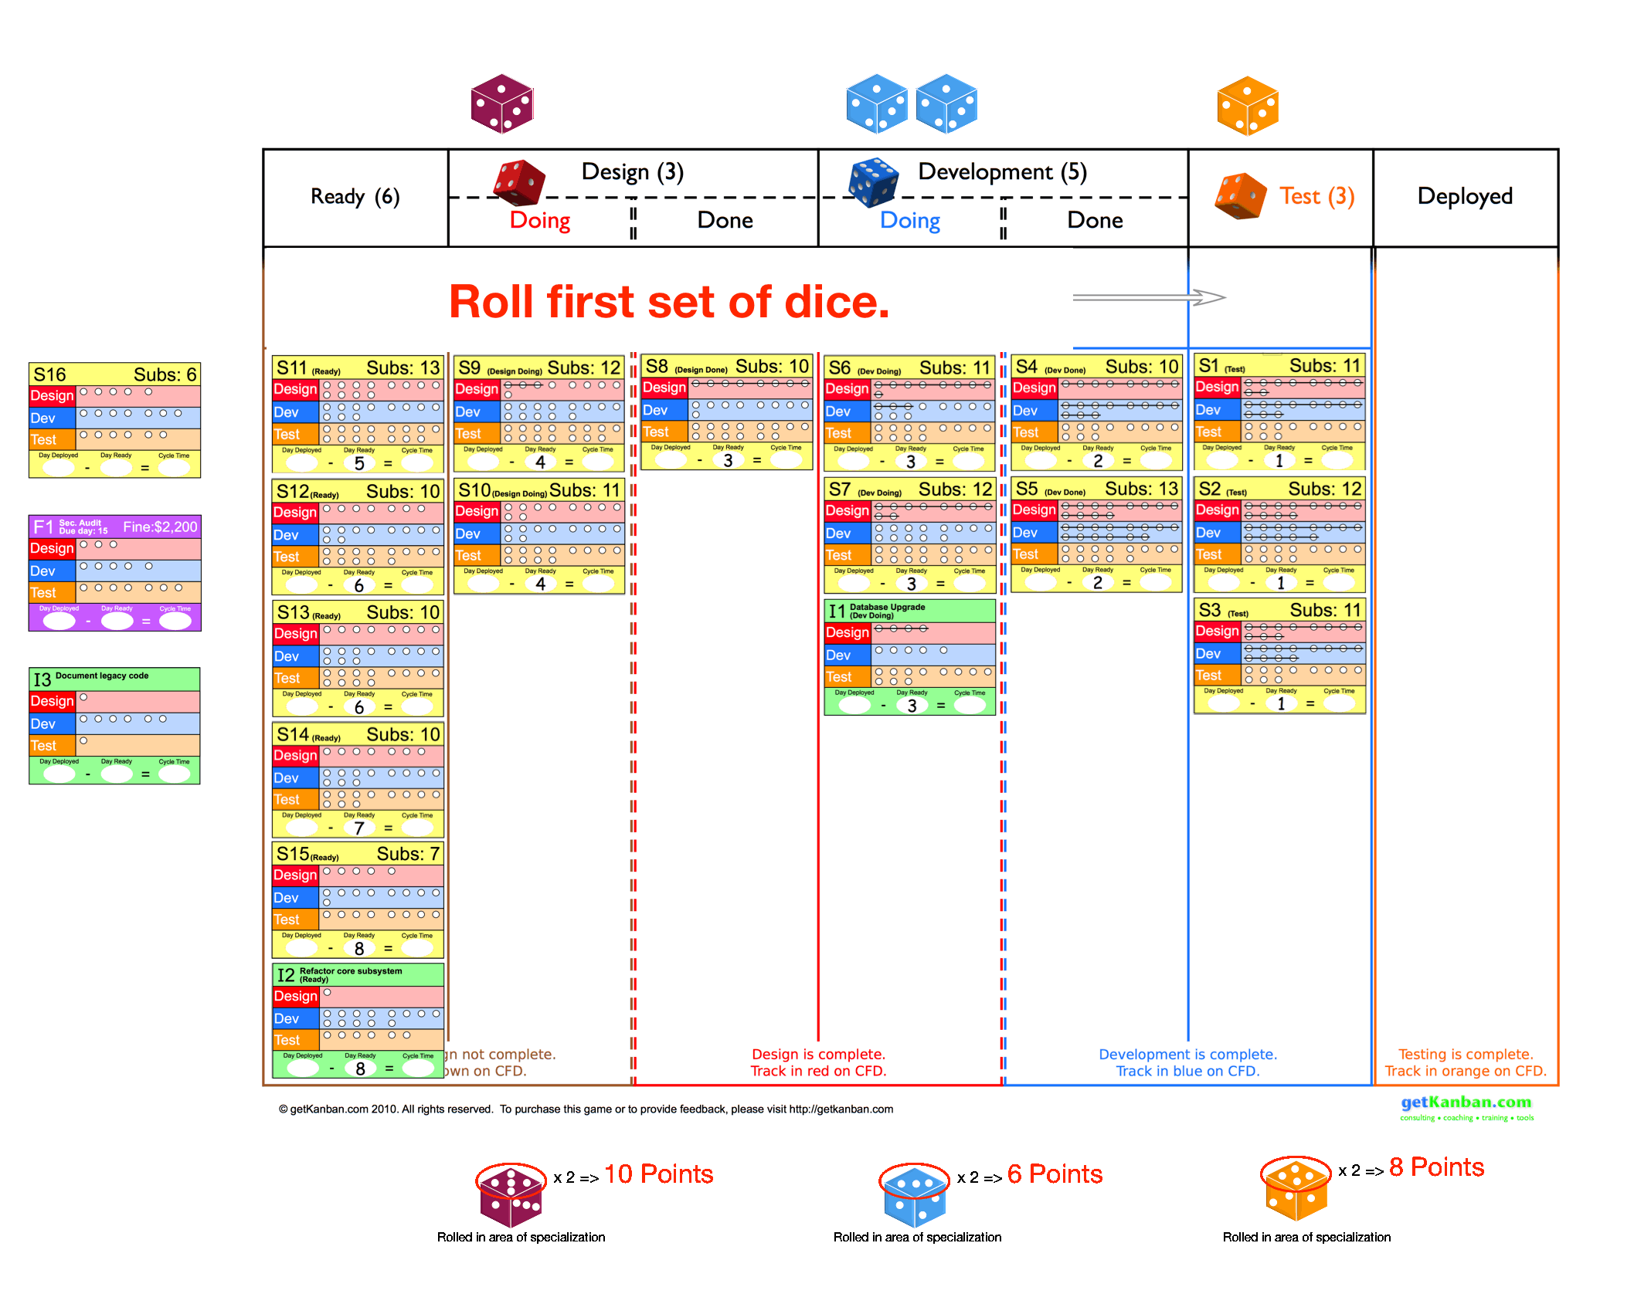

Slide 10
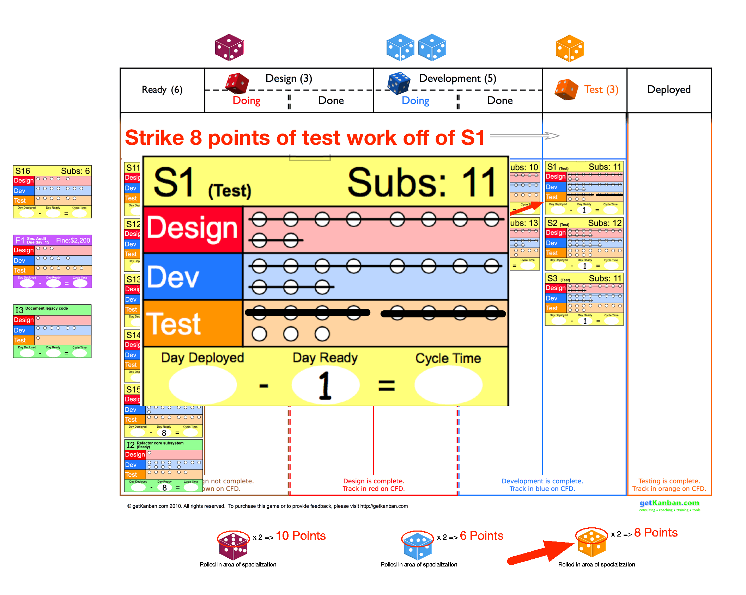

Slide 11
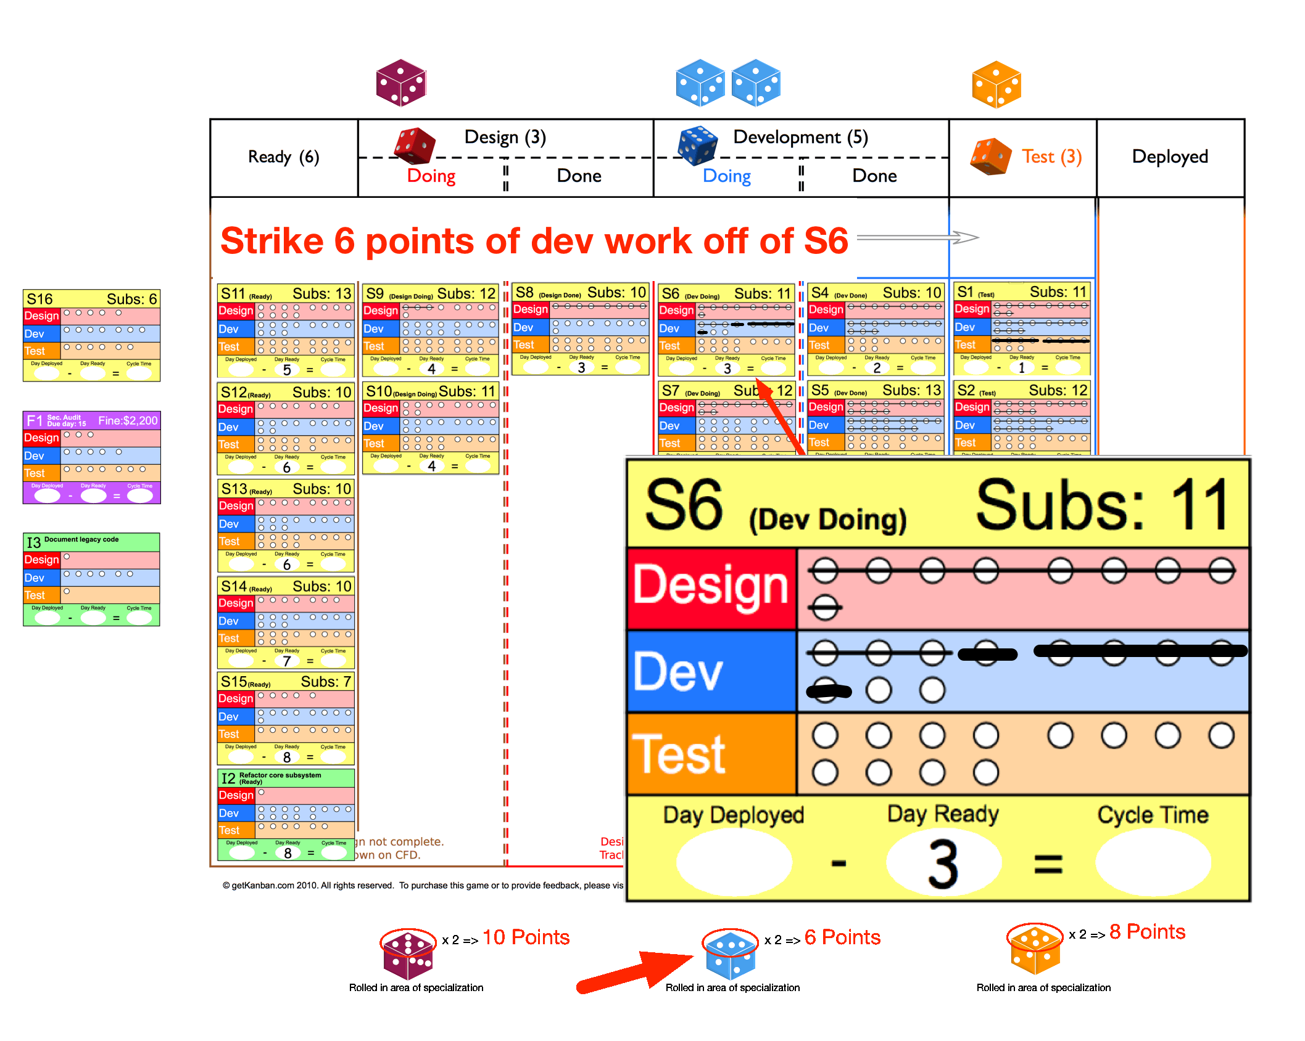

Slide 12
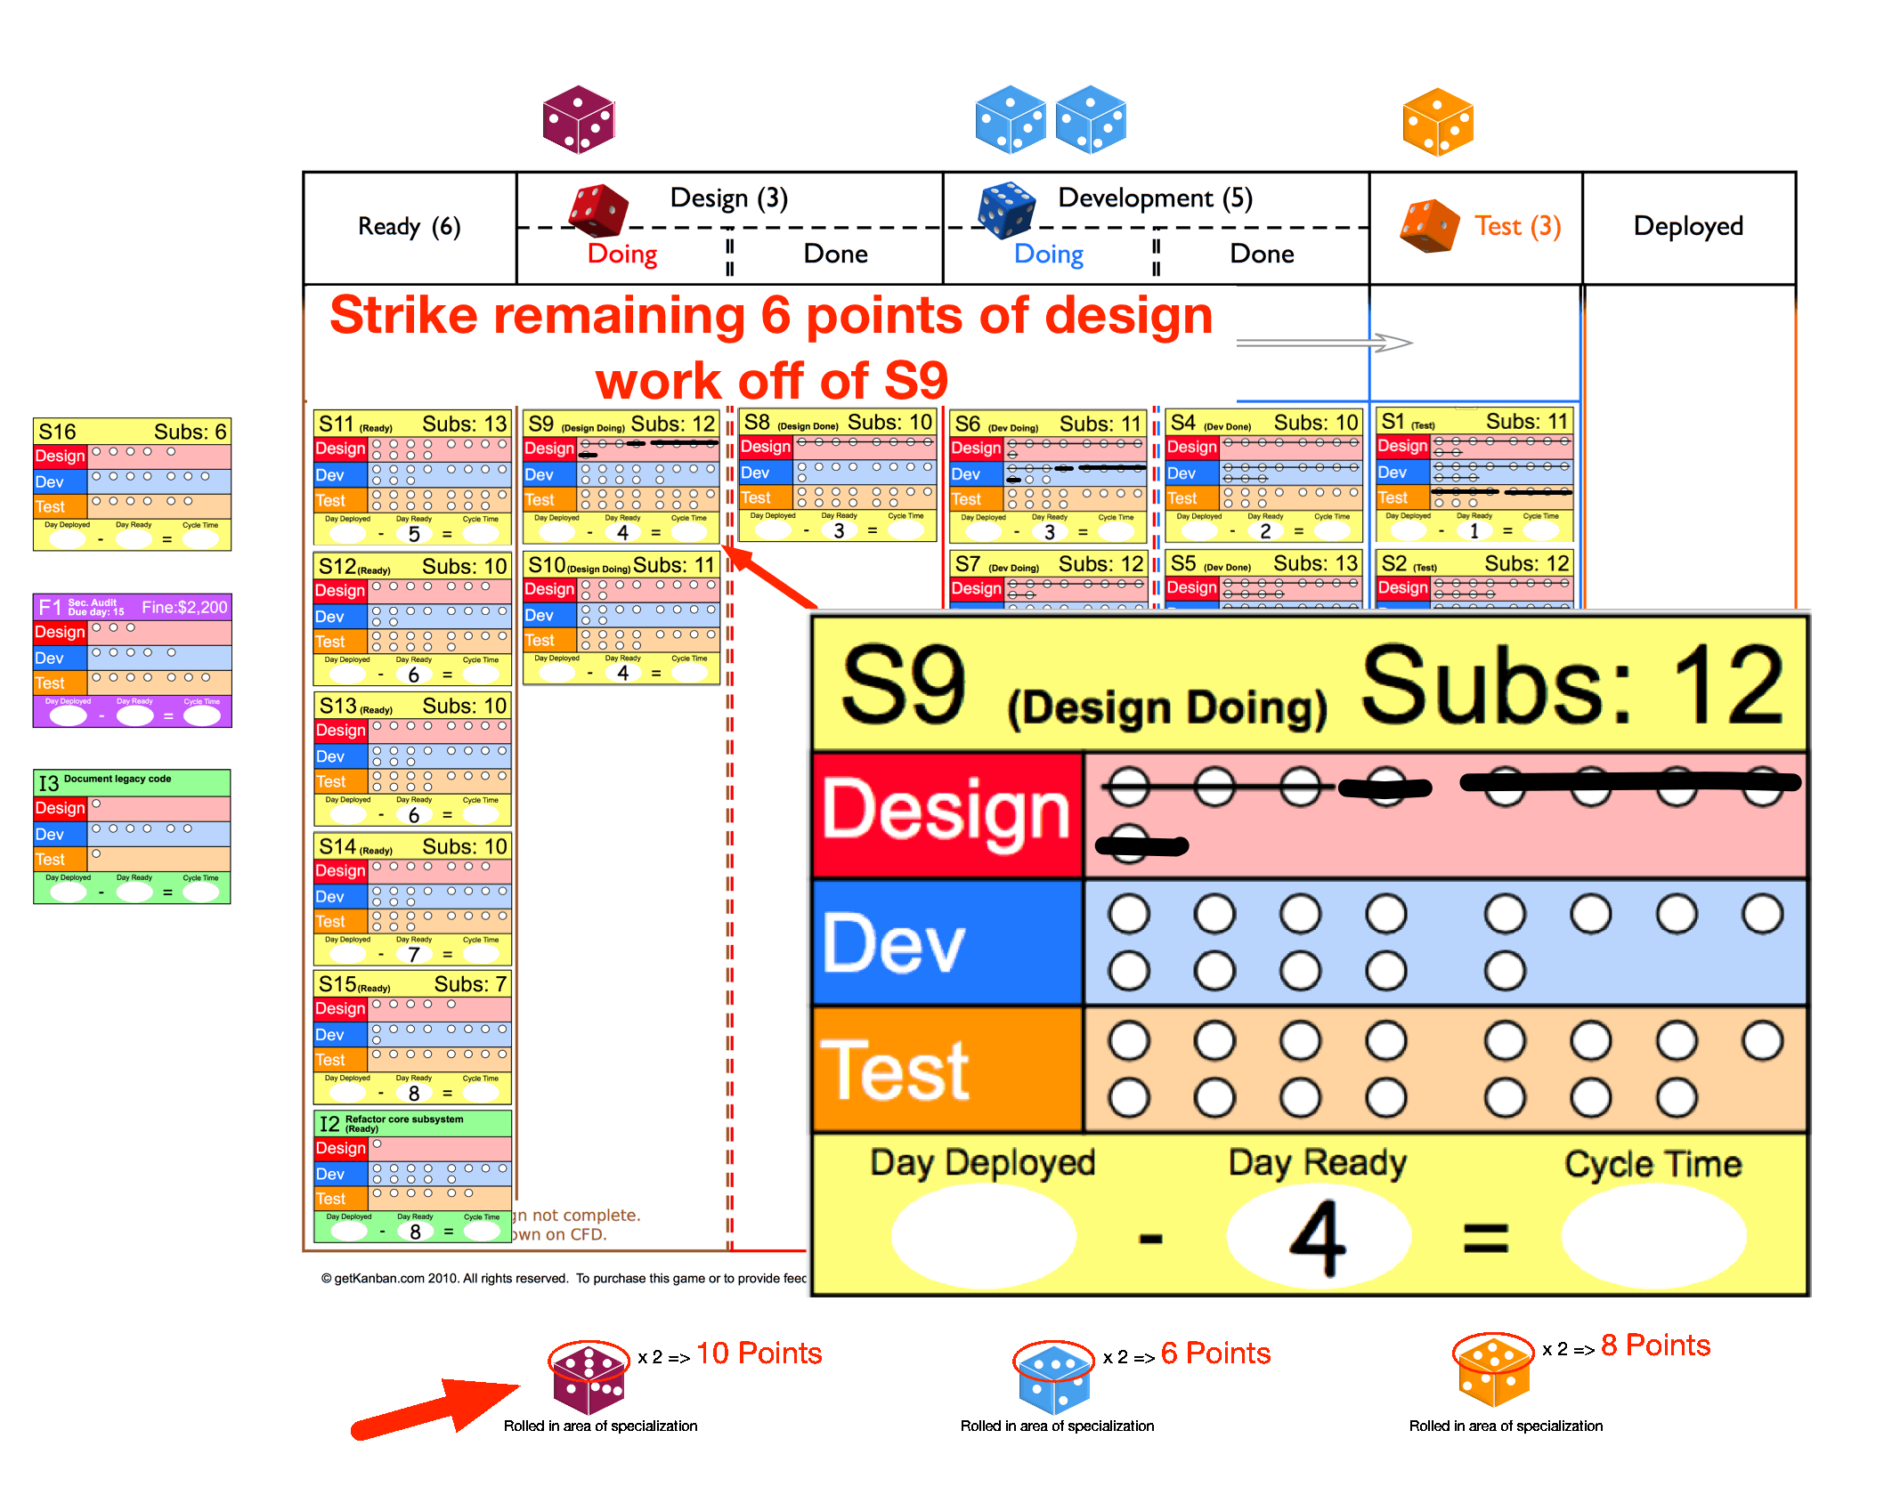

Slide 13
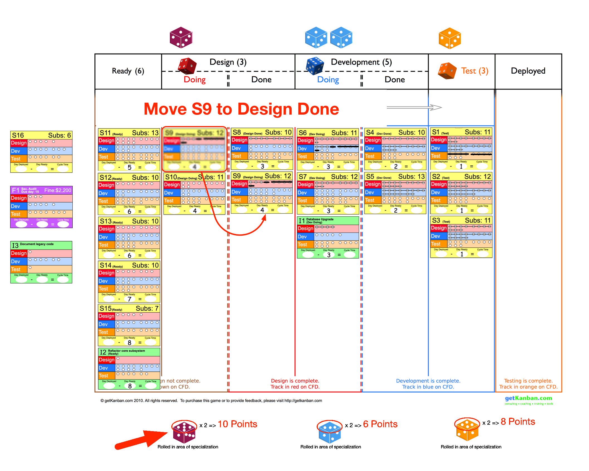

Slide 14
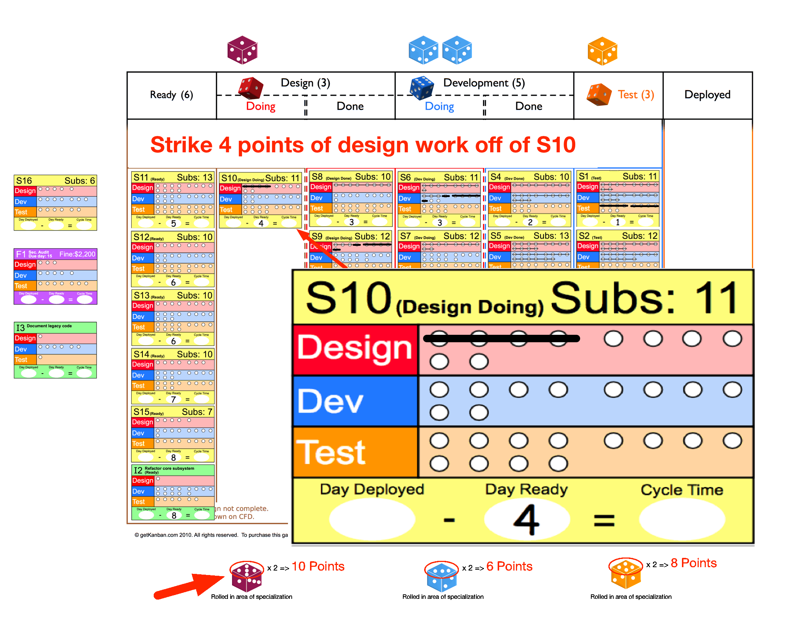

Slide 15
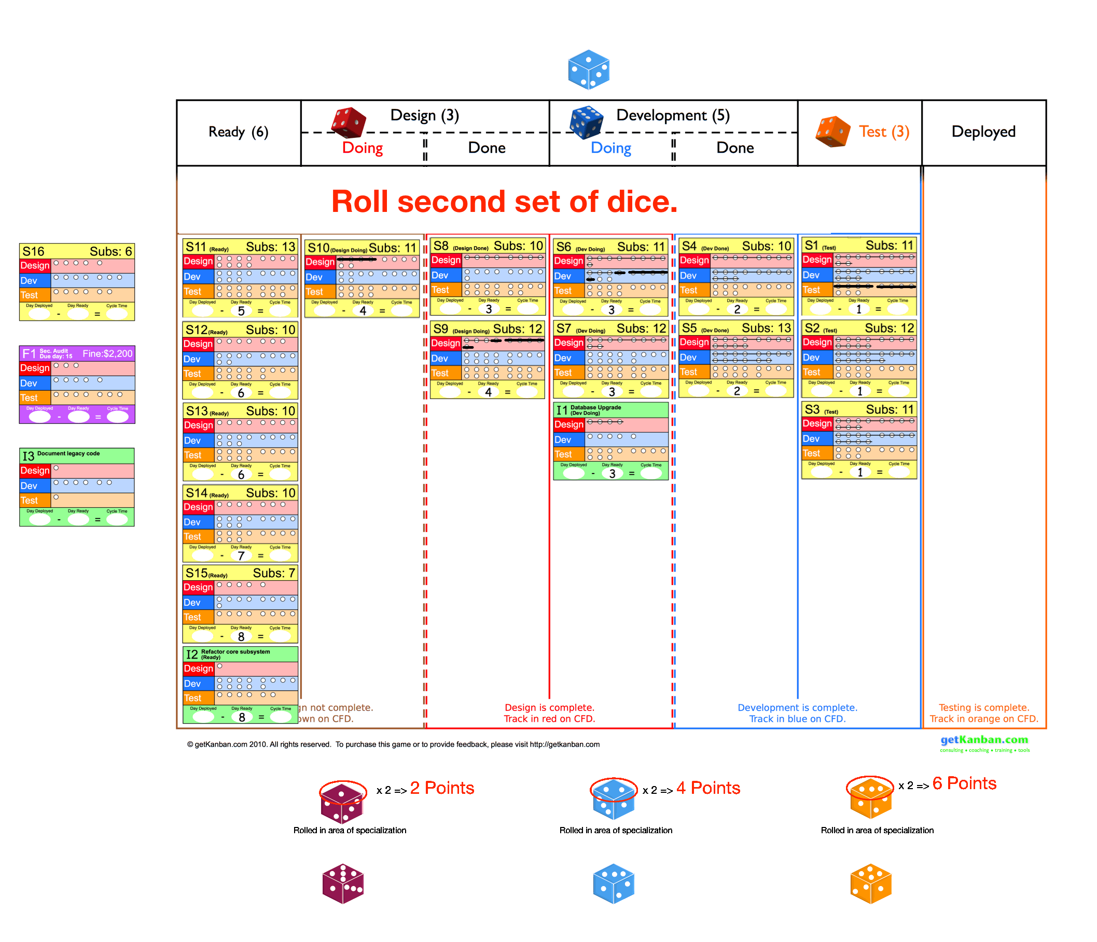

Slide 16
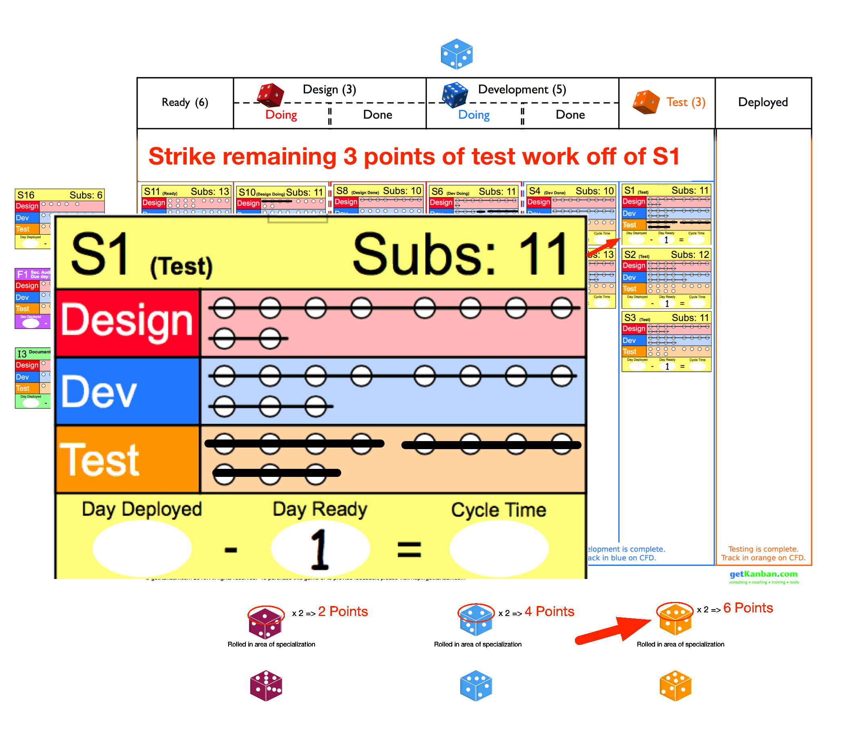

Slide 17
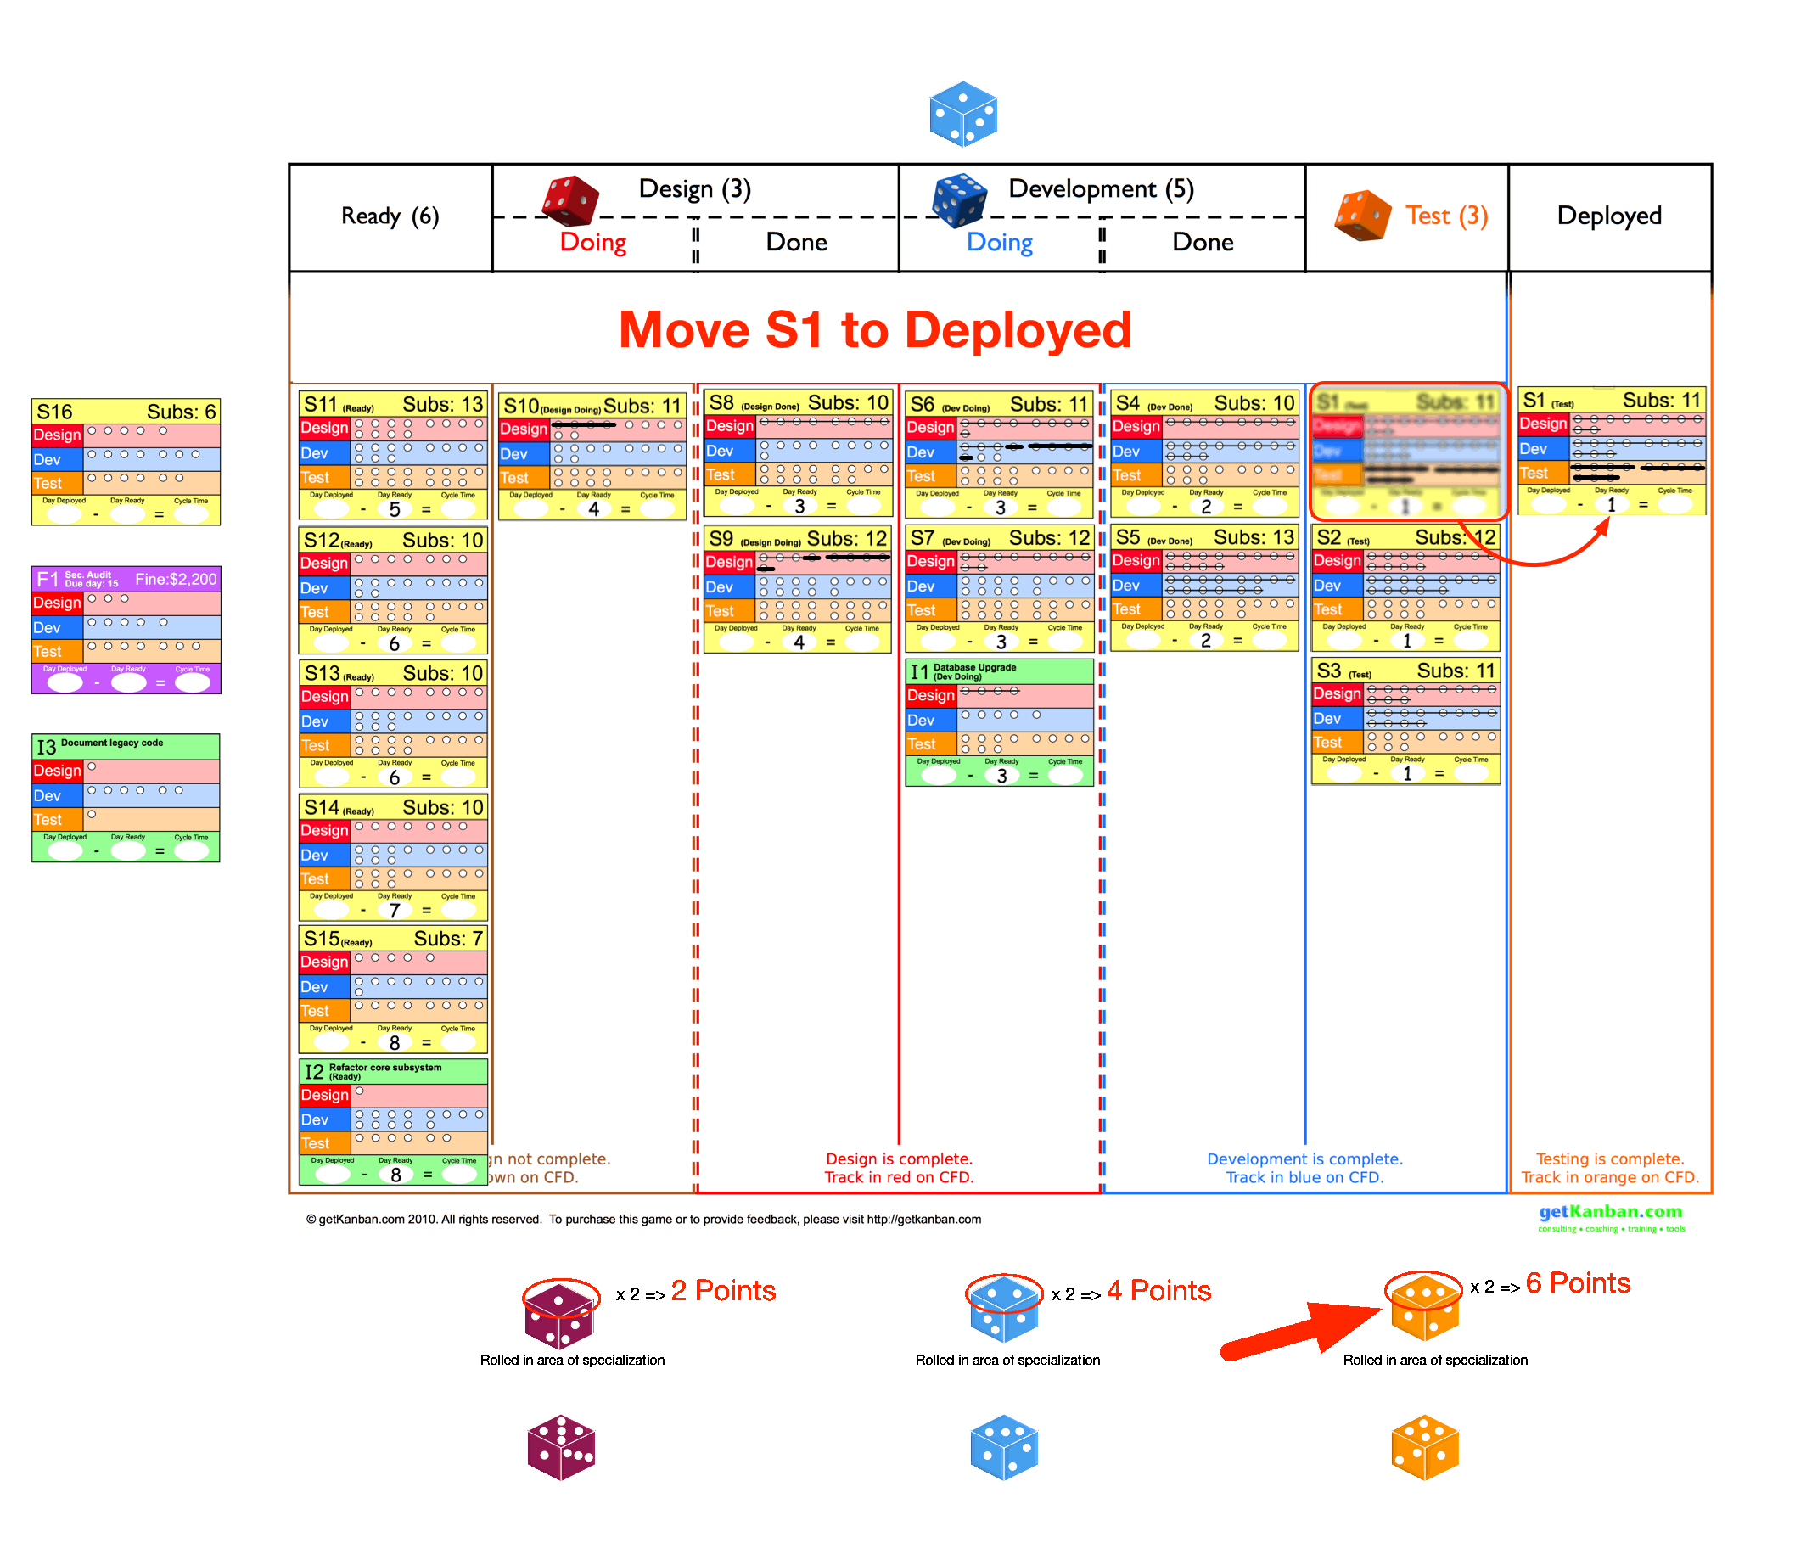

Slide 18
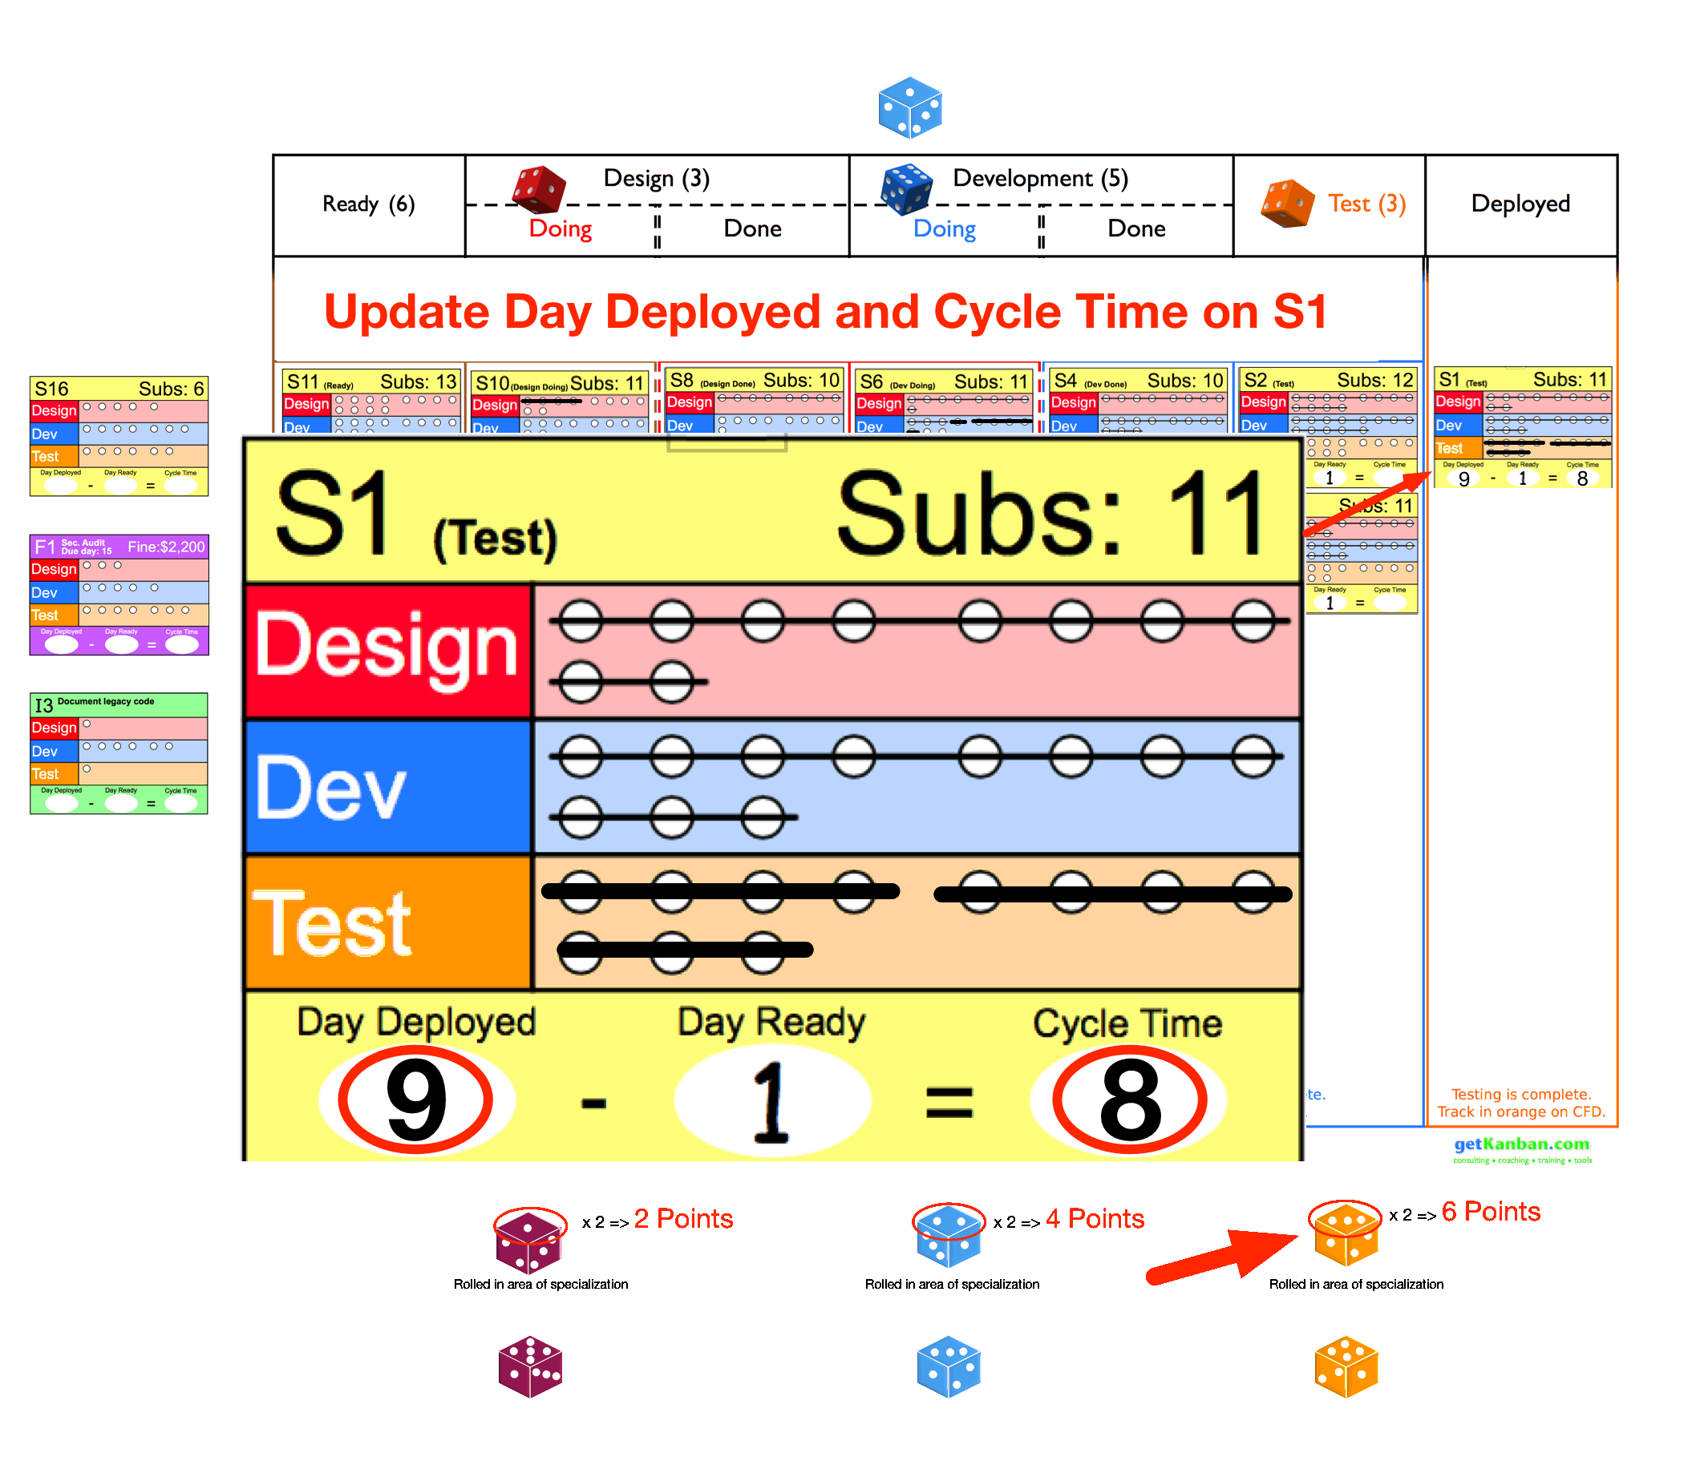

Slide 19
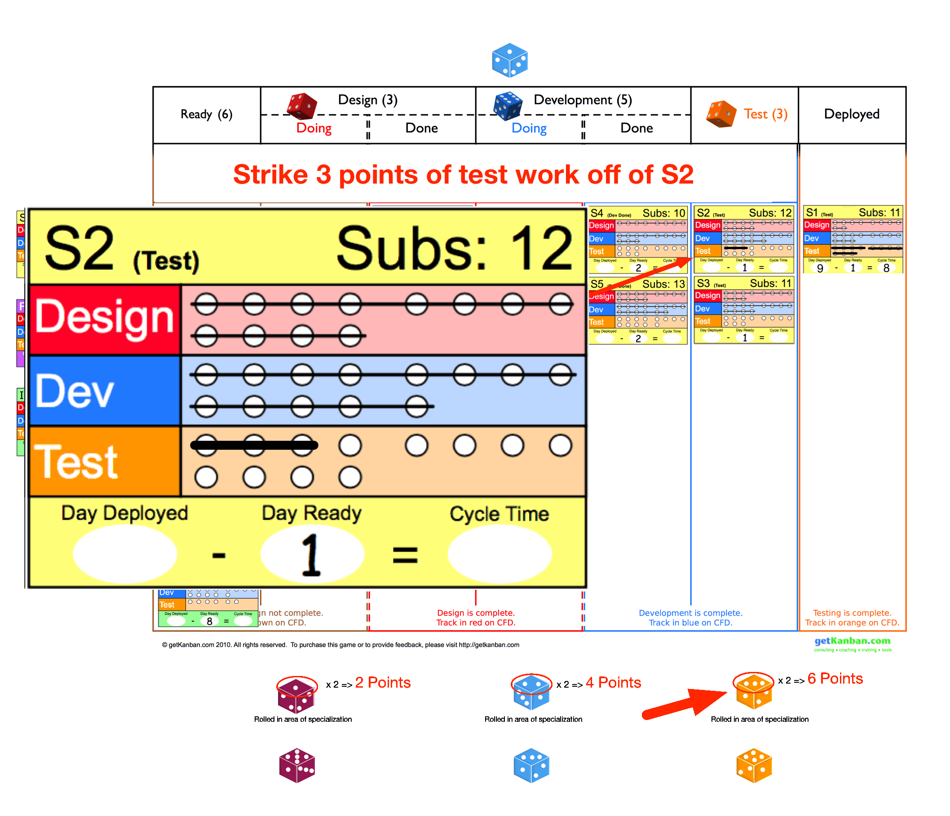

Slide 20
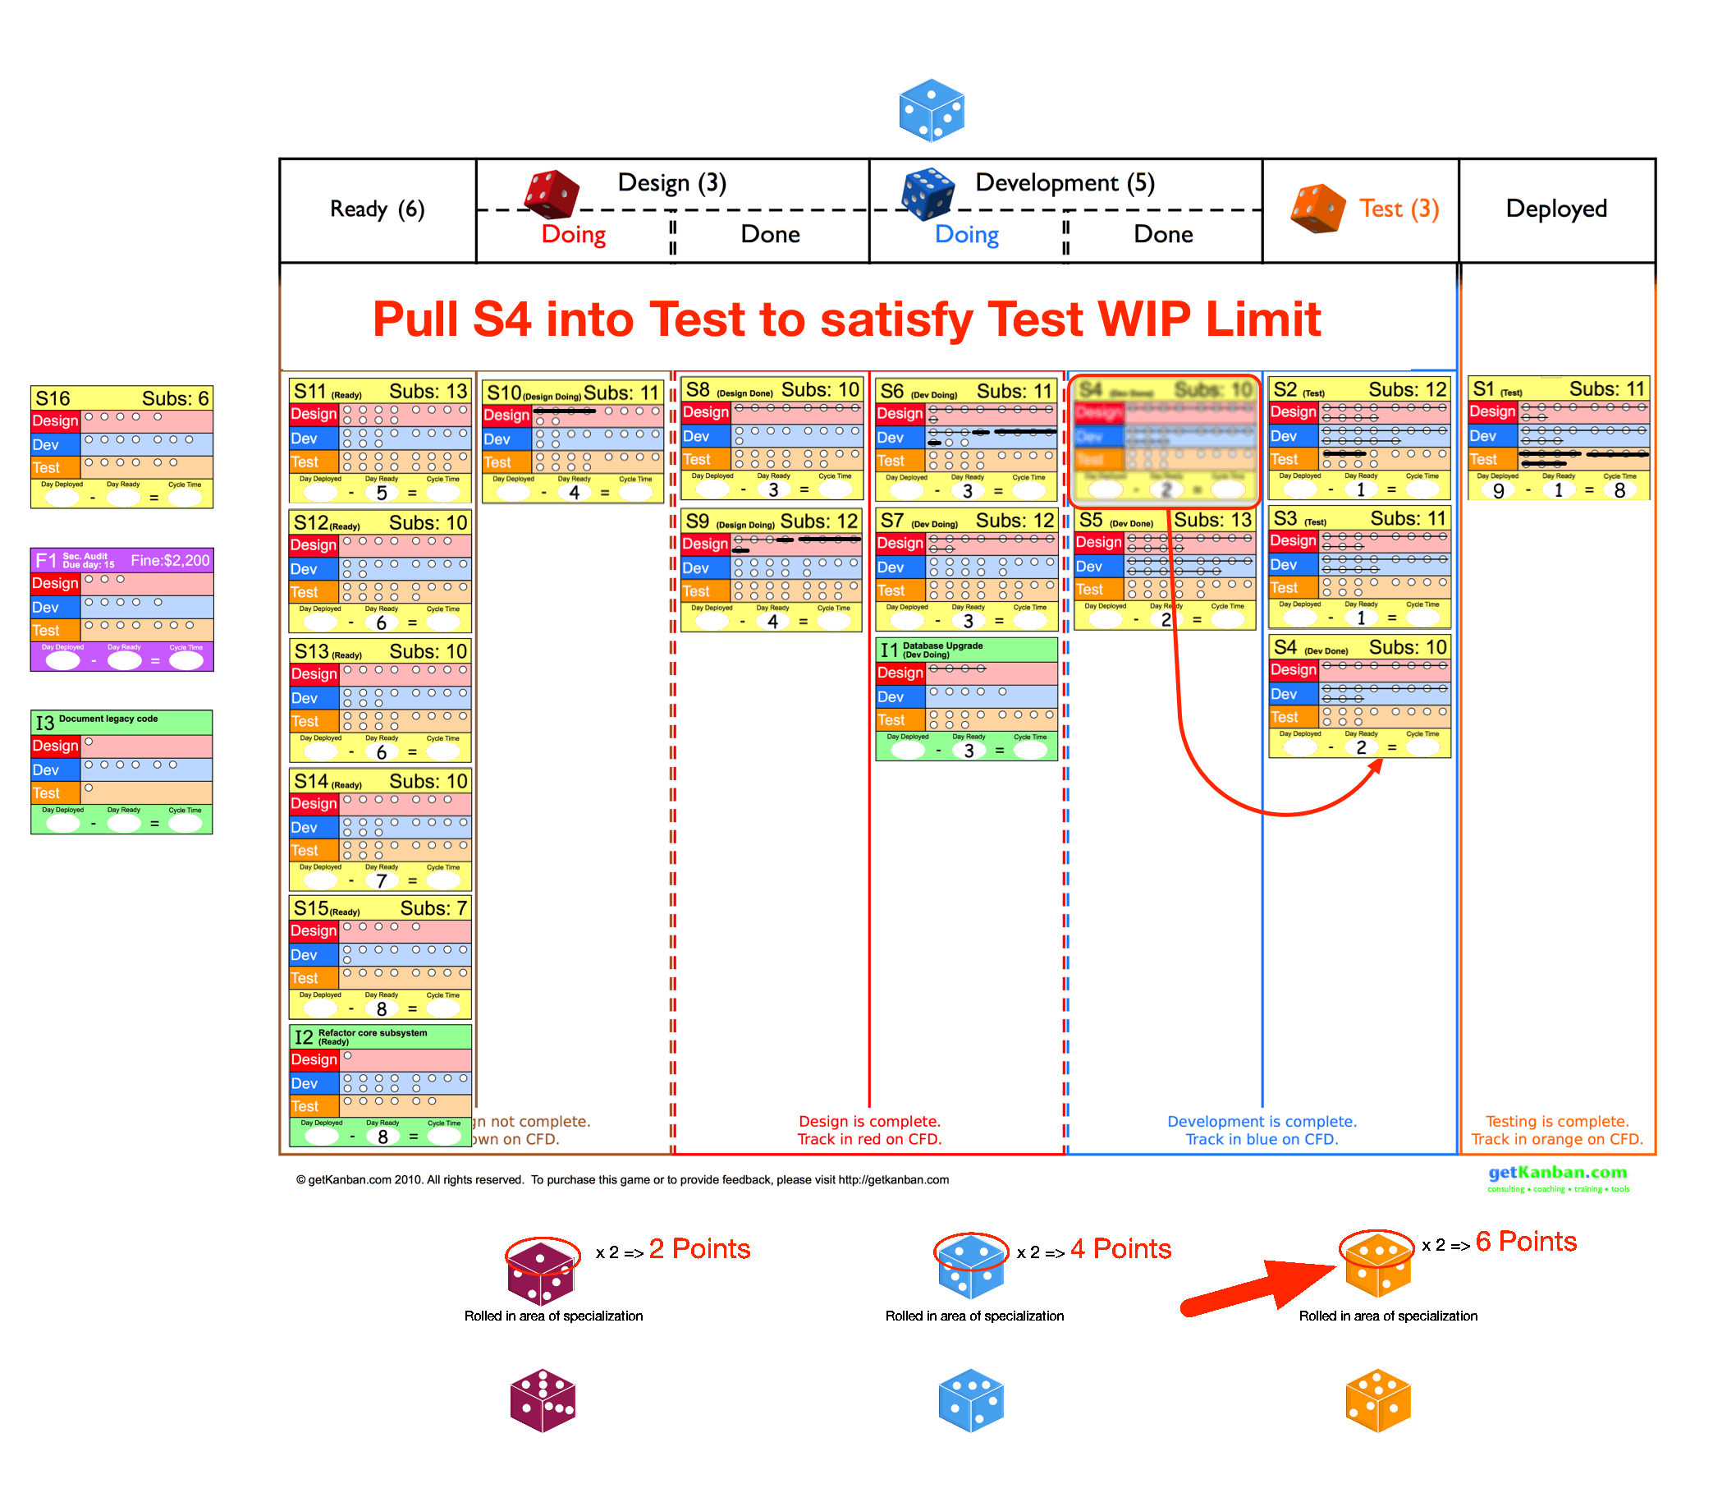

Slide 21
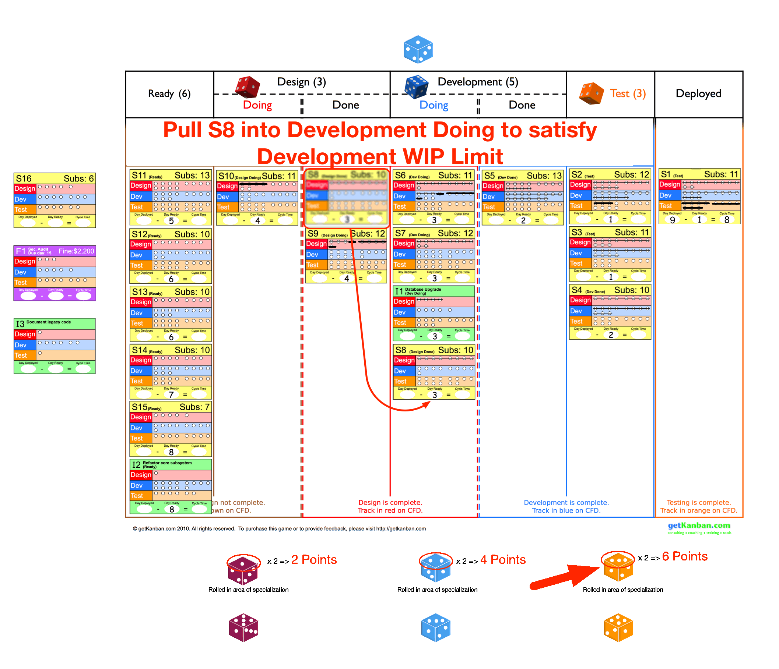

Slide 22
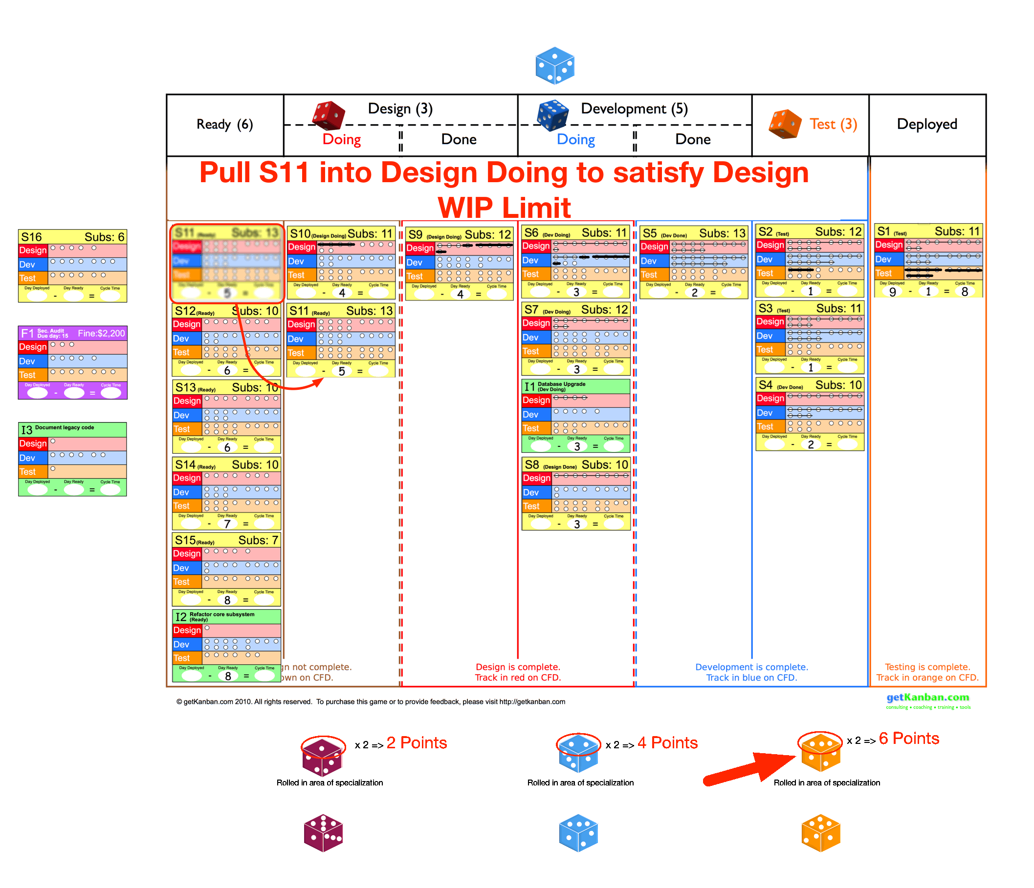

Slide 23
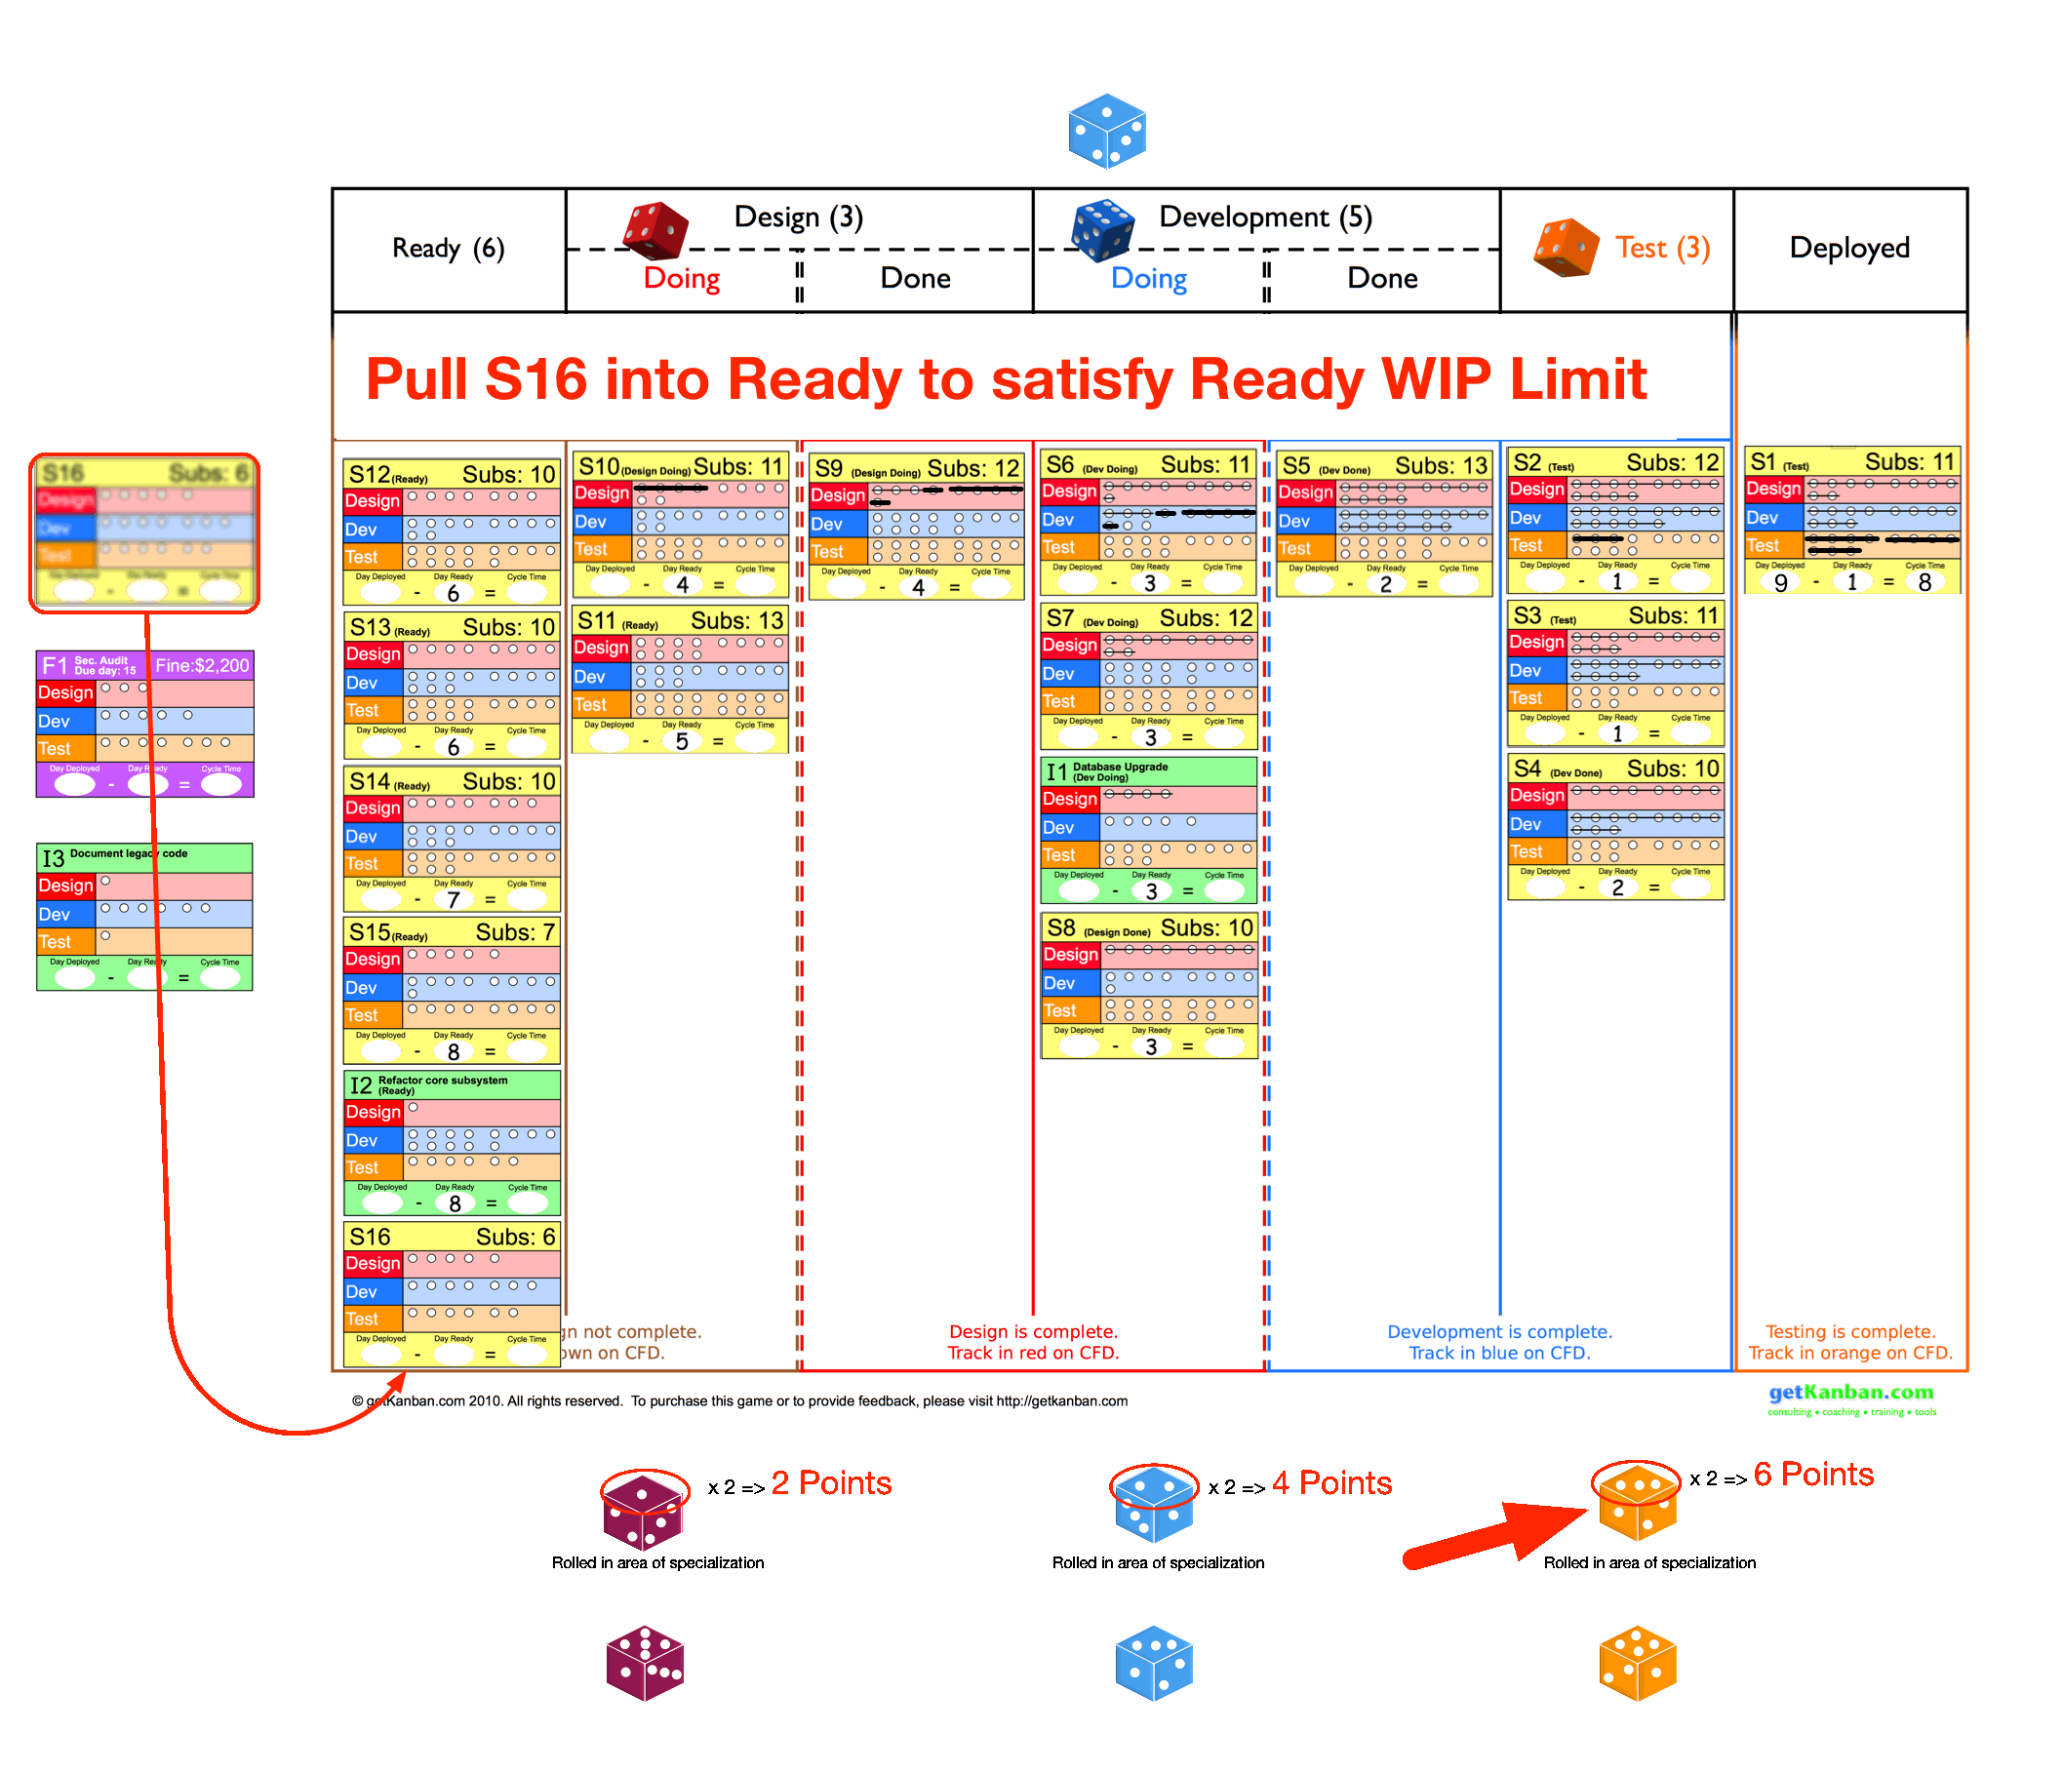

Slide 24
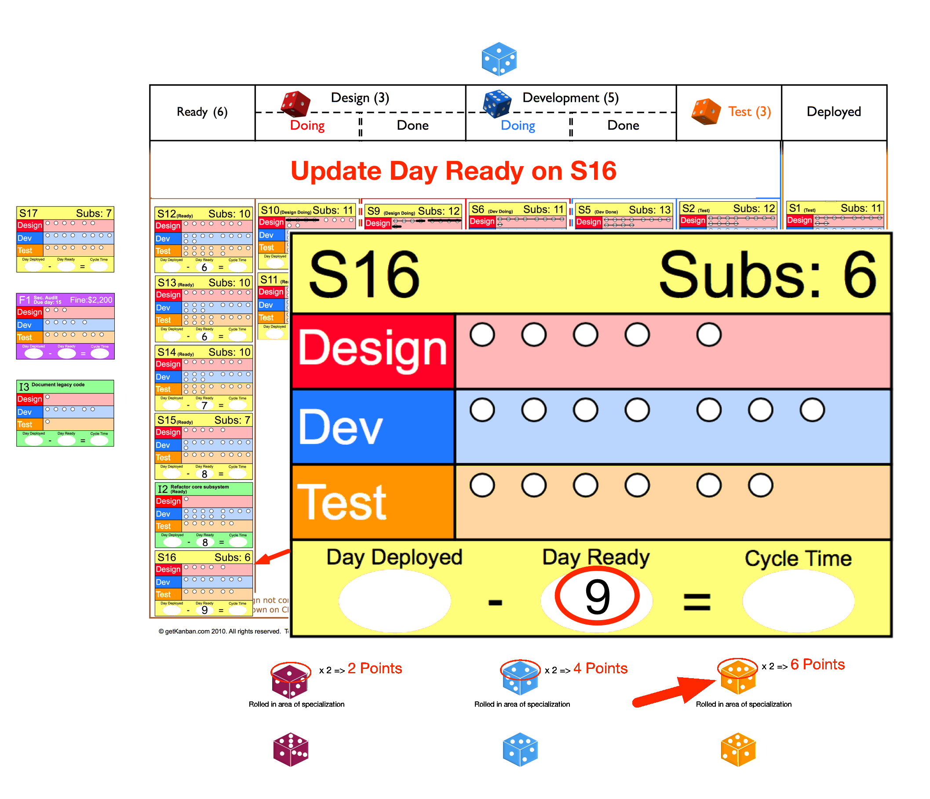

Slide 25
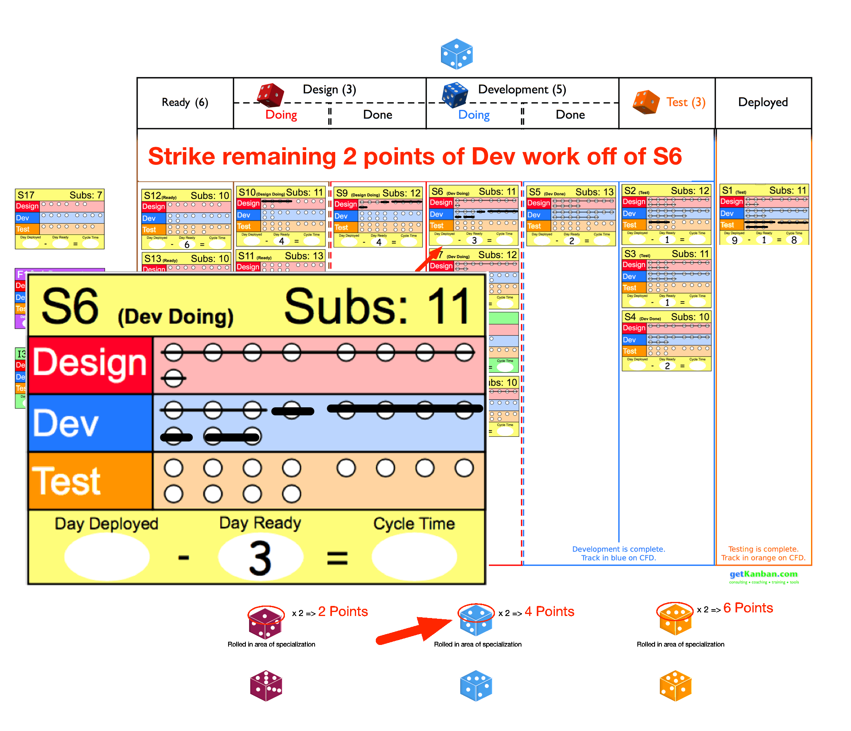

Slide 26
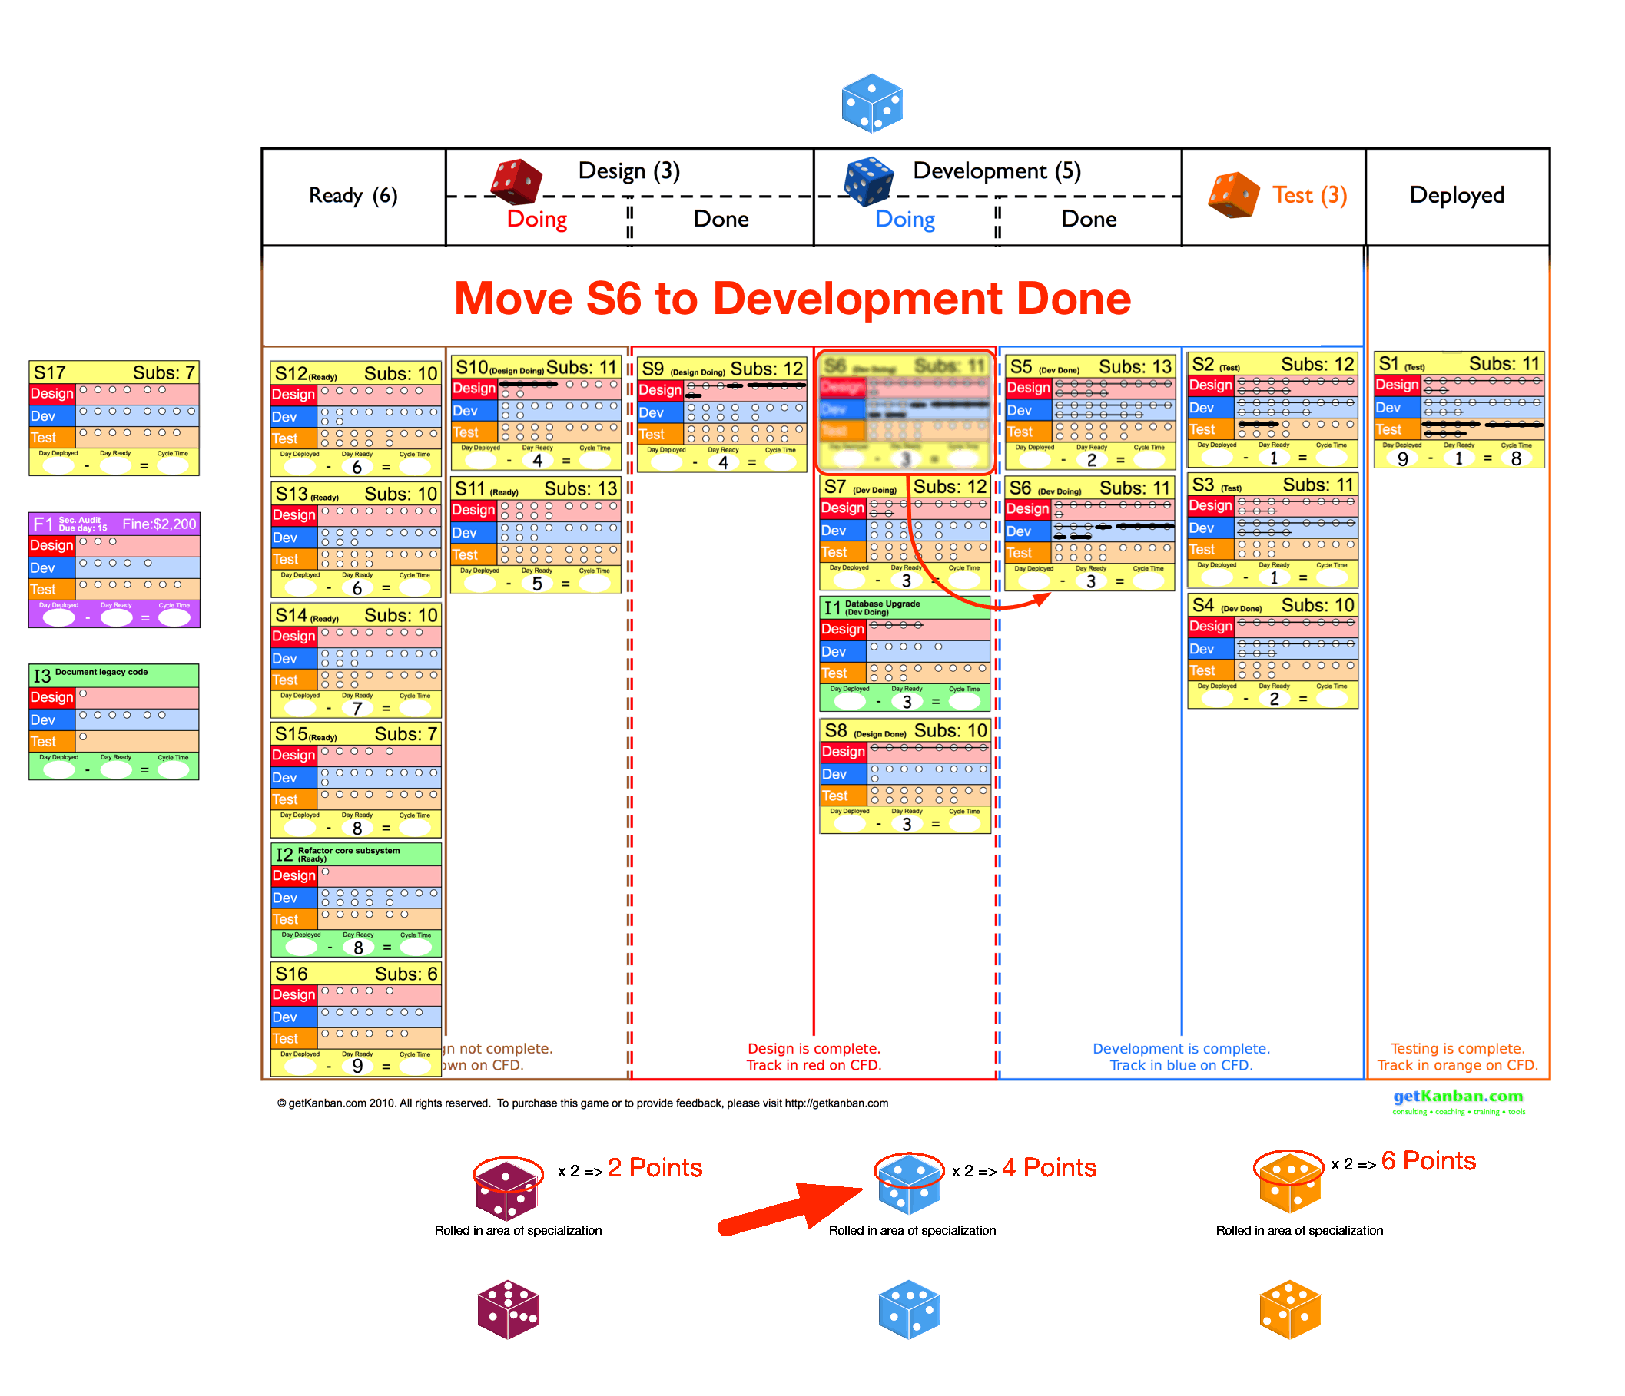

Slide 27
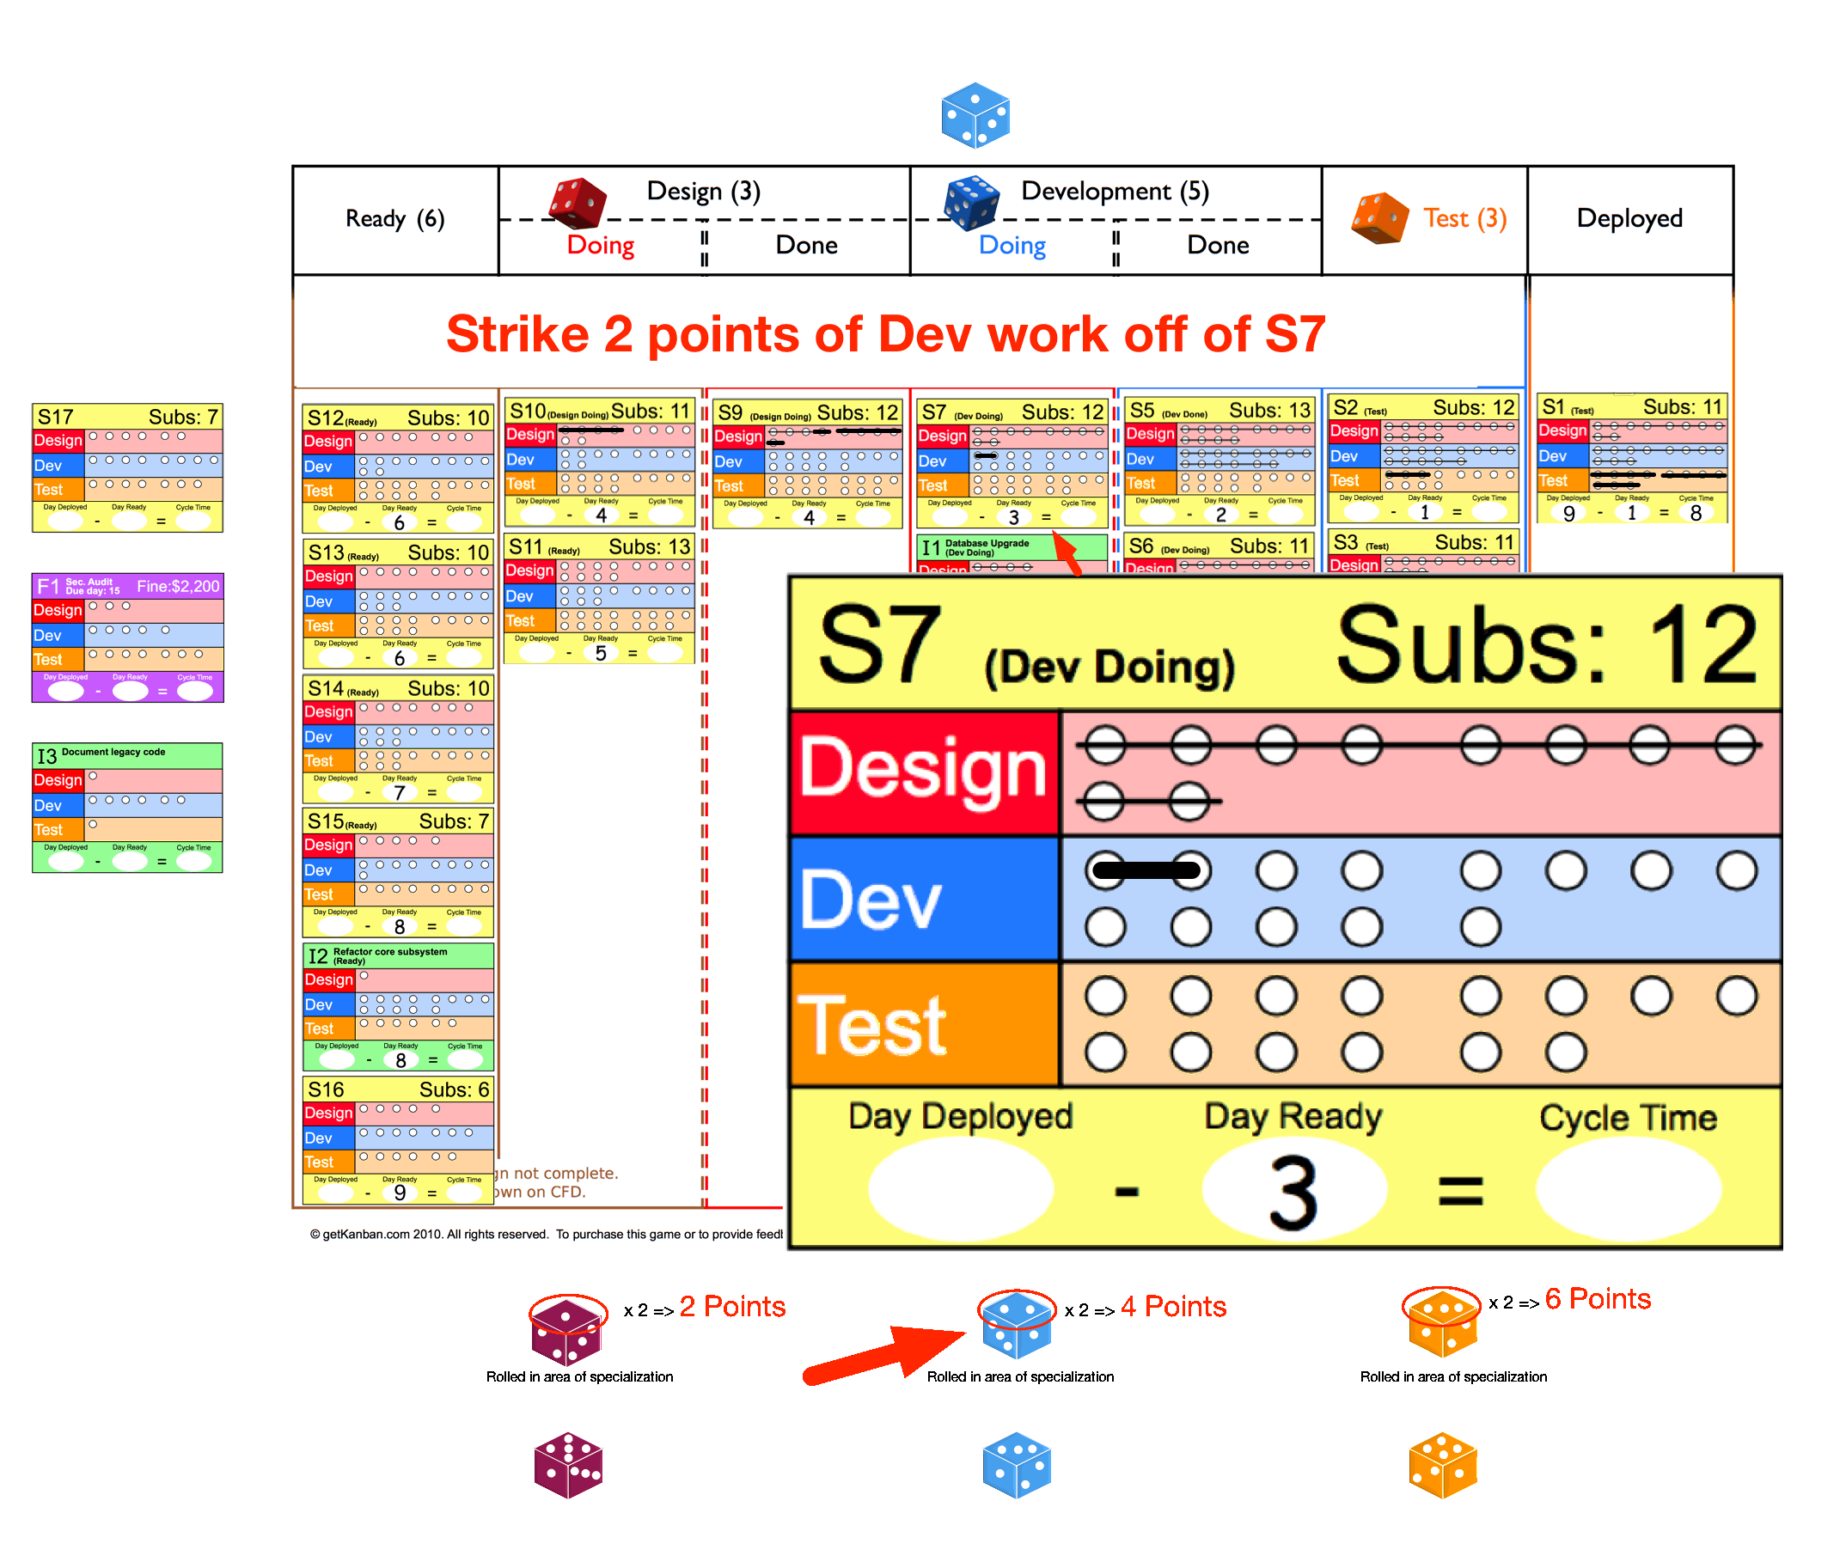

Slide 28
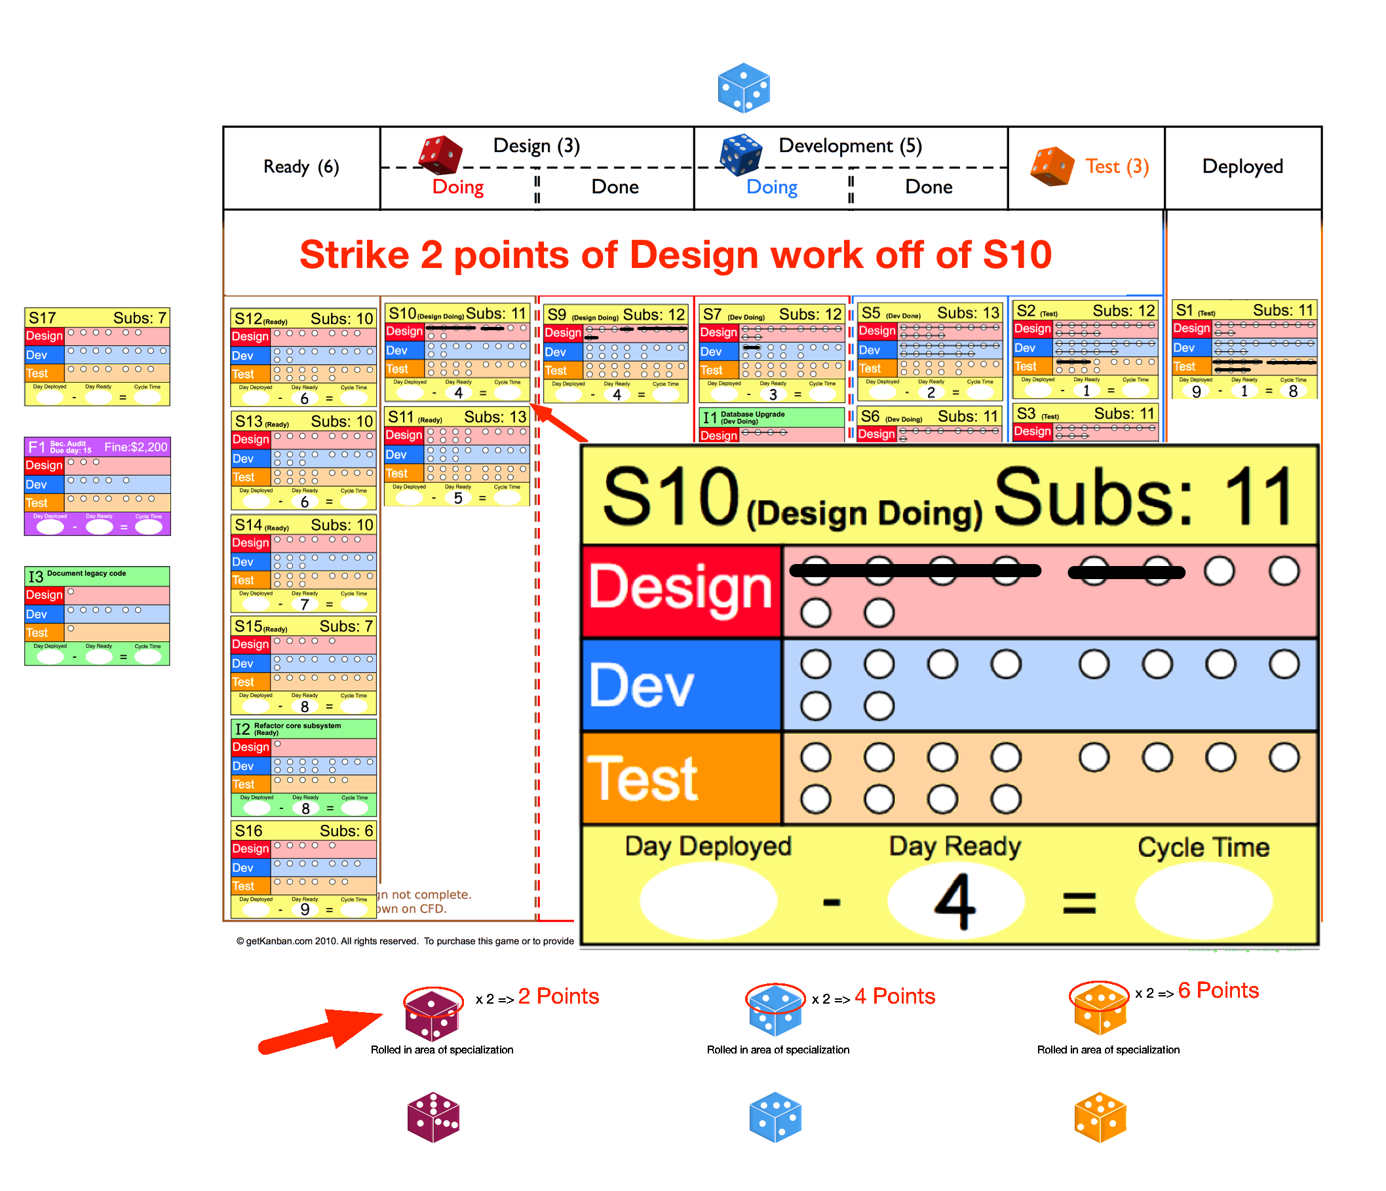

Slide 29
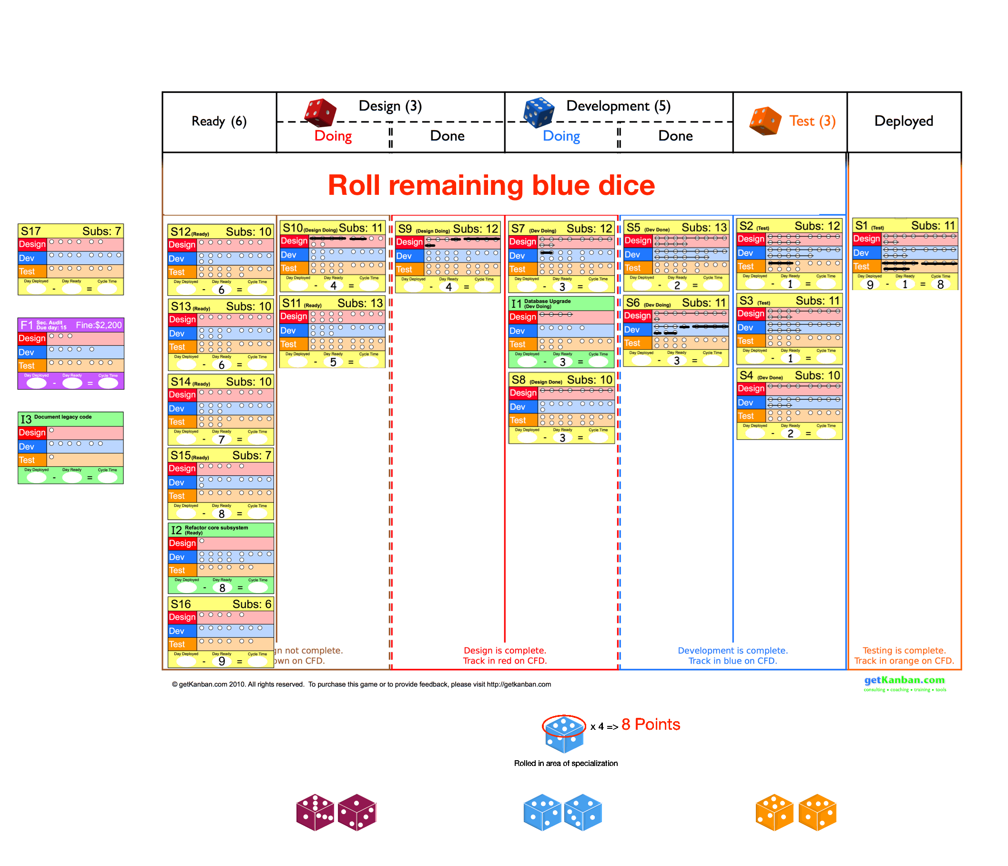

Slide 30
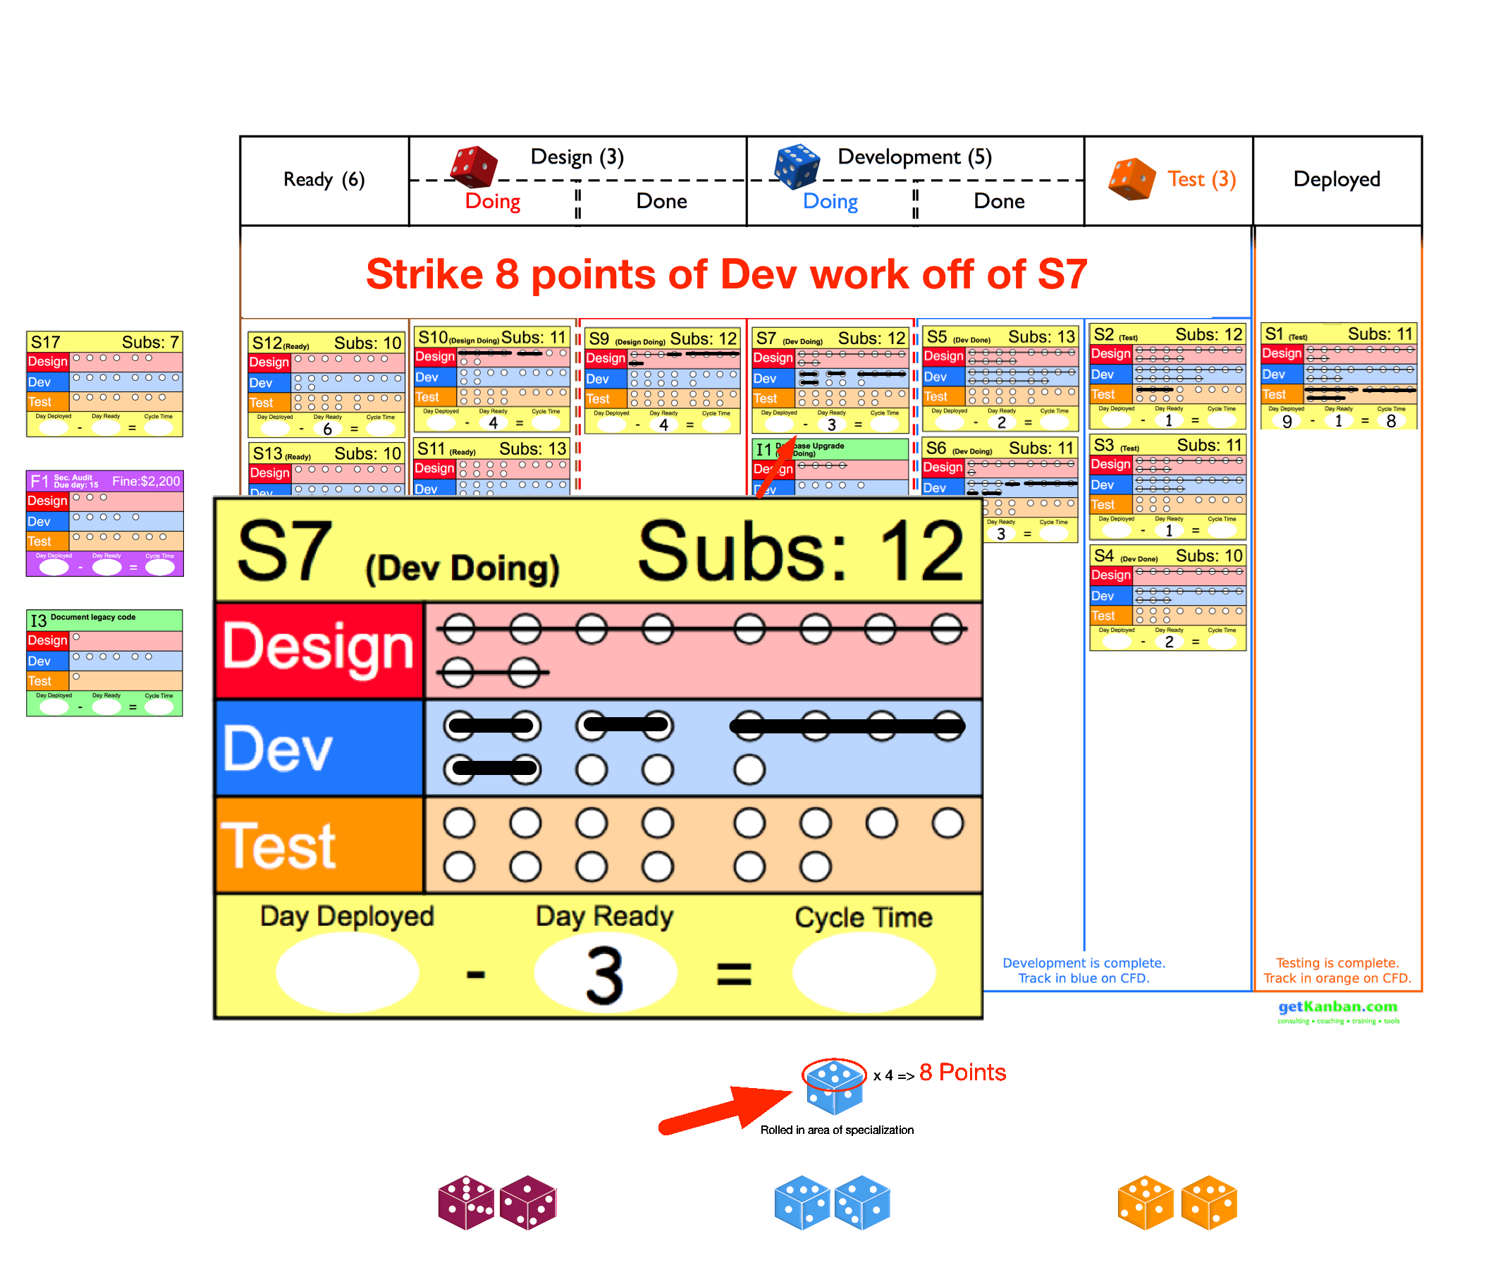

Slide 31
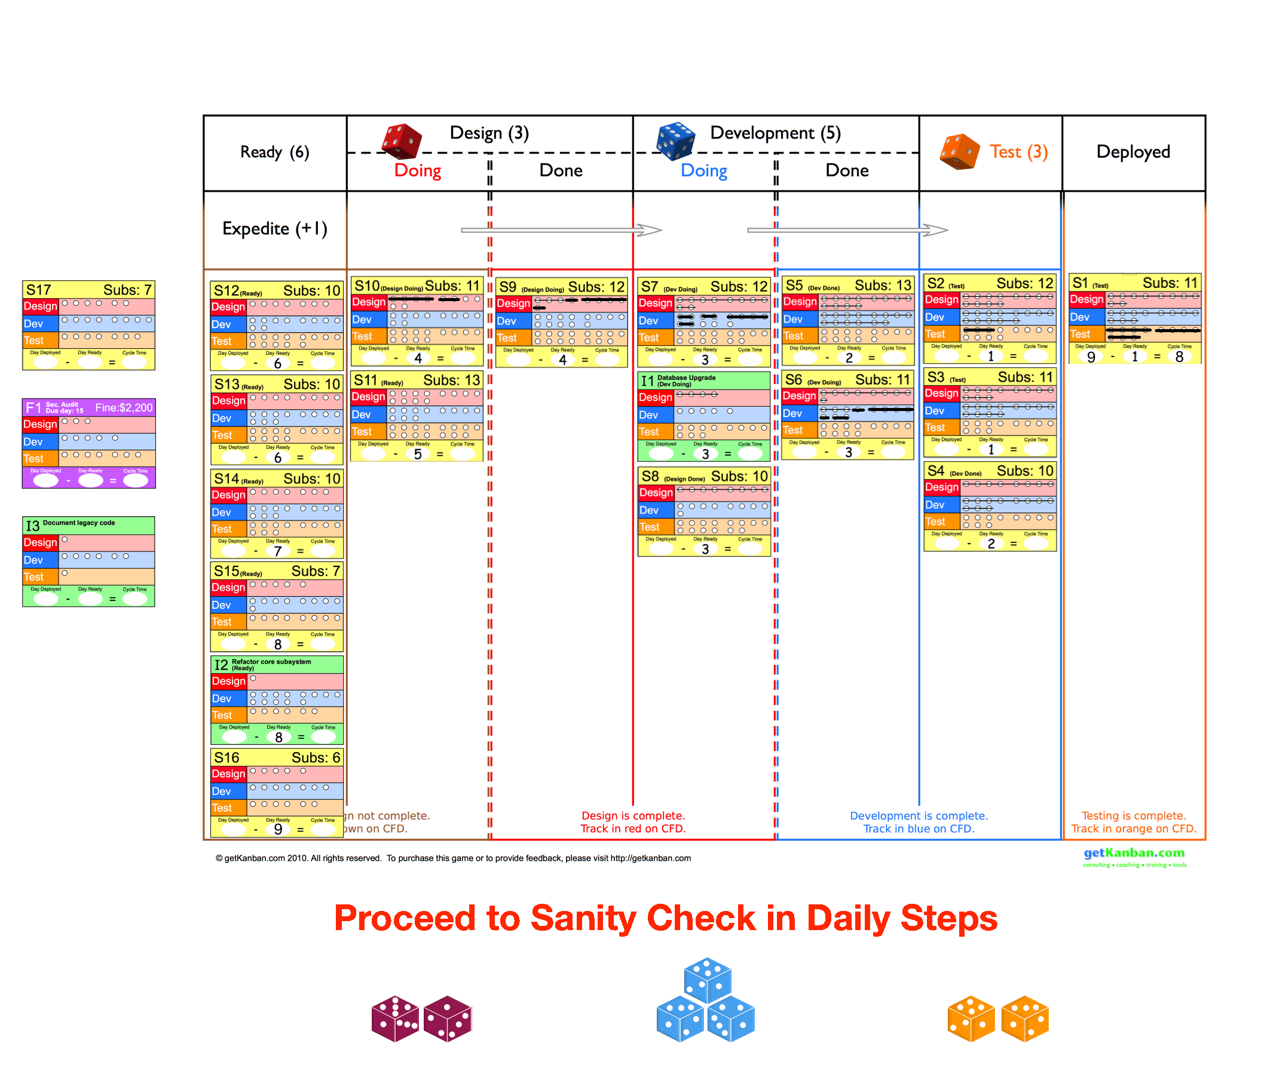

Slide 33
WIP limits are honored
Day Ready is updated on any new stories
Day Deployed and Cycle Time are updated on any deployed stories

